Slide 1
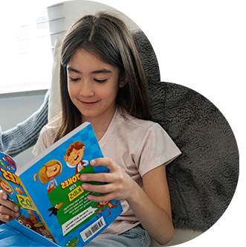

Reading and wellbeing How books and stories can help us feel better, understand our emotions and deal with challenges.

Slide 2
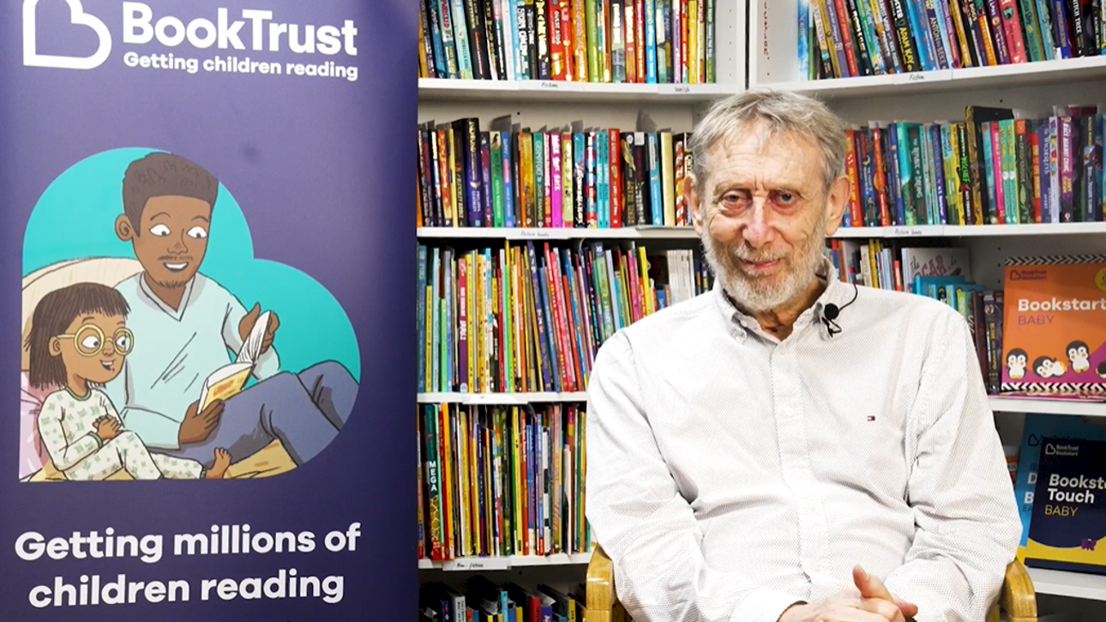
Exploring feelings

Slide 3

Exploring feelings
Reading can help you understand your emotions.
You can learn about difficult feelings in a safe way through the characters in books.
When you read about a character’s emotional journey it can help you deal with your own.

Slide 4
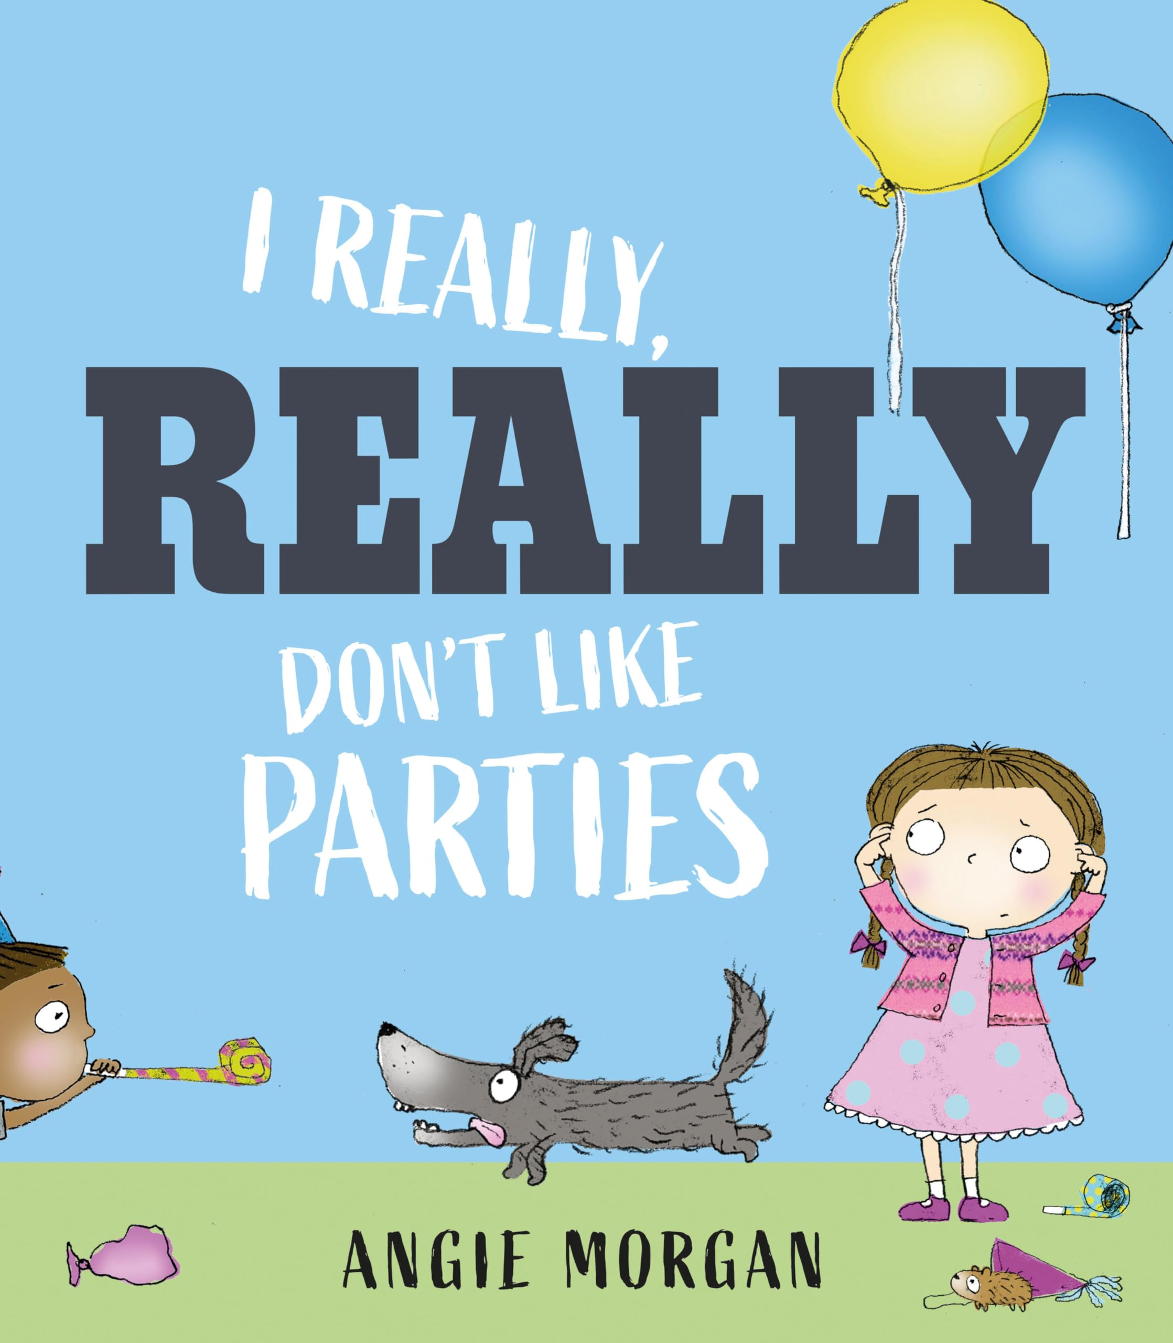
In this book, the main character is nervous about parties because they are too loud and busy.
She decides to face her fears and go to a party even though she is worried.
At the party she meets a new friend who is also shy. They end up playing together and have a great time.
How might this story help someone who reads it?
©️Angie Morgan 2024

Slide 5
Books as relief

Slide 6
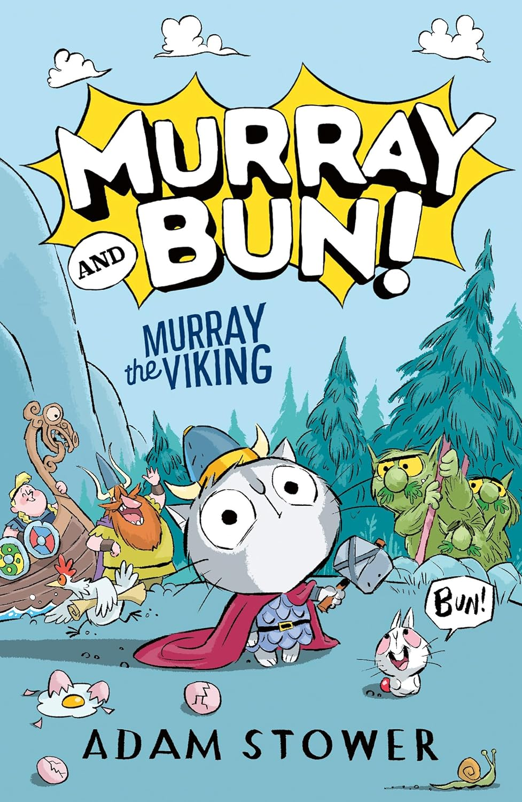
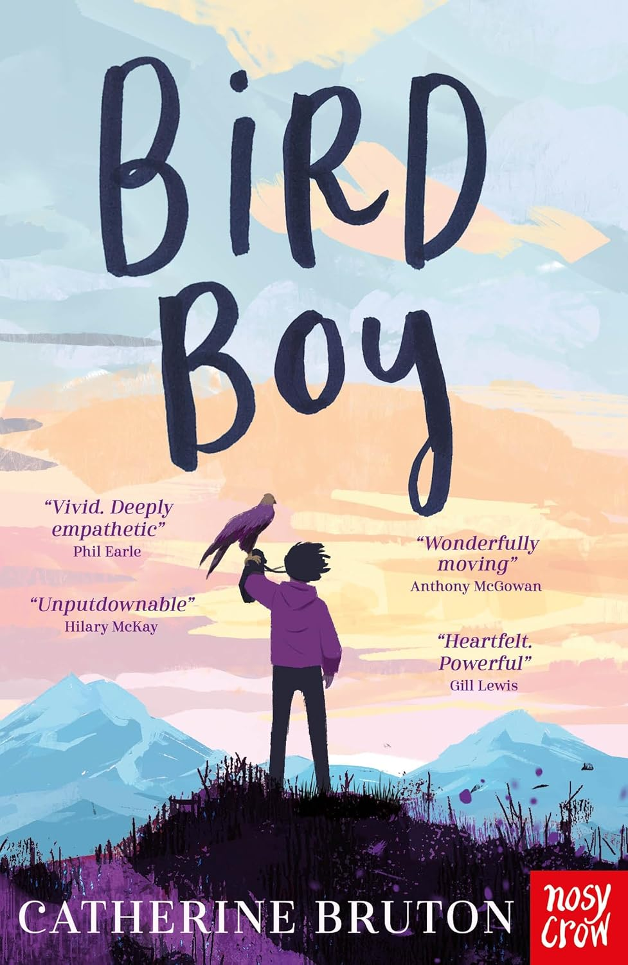
Relief from stress
Books can help you feel better by relieving worries and anxiety.
Different types, or genres, of books might do this in different ways.
Look at these two covers, what kind of books do you think they are?
©️Adam Stower 2024
©️Catherine Bruton 2024

Slide 7
Here are some popular genres:
Comedy: Laugh along with a funny book!
Fantasy: Escape to magical worlds.
Sci-fi: Wonder at distant galaxies and technology.
Non-fiction: Learn skills and explore your passions.
Horror: Give yourself a scare with a spooky story!
Action: Get your heart racing and battle baddies!
Poetry: Play with language and express emotions.
Mystery: Follow the clues and catch a killer!
Myths + folklore: Lose yourself in traditional tales.
Diaries: Immerse yourself in a character’s thoughts.
Do you have a favourite genre?

Slide 8
Books are a place you can go

Slide 9

Books are a place you can go…
Each book you read is a new world just for you.
You can visit these worlds to take a break from things that make you feel down.
You can use the worlds in books as places to confront your feelings and understand them.

Slide 10
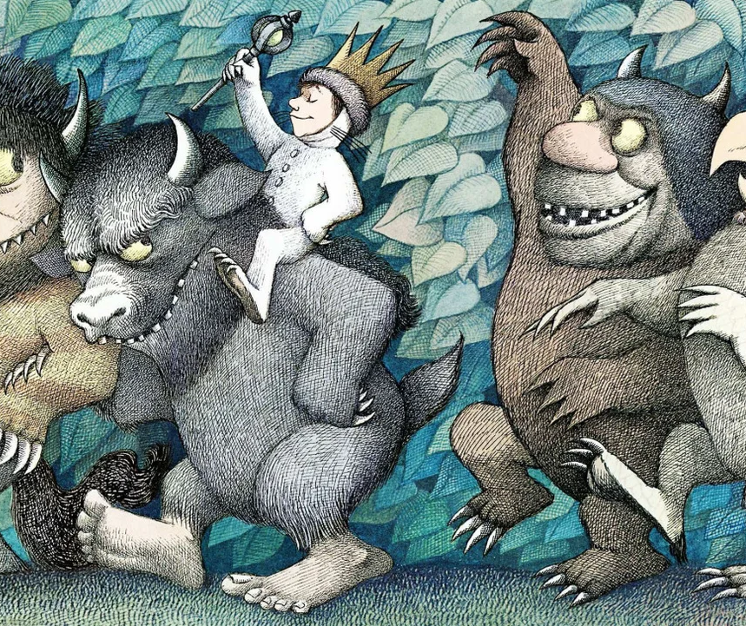
In Where the Wild Things Are Max discovers a magical world after he is sent to bed for being naughty.
In this world, Max meets the Wild Things. They are loud and angry, just like Max was at home.
Max ends up taming the Wild Things and becoming their king.
The wild monsters are like Max’s feelings of anger. He learns to control his anger and then comes home.
How might Max’s adventure help somebody to think about their own feelings of anger and frustration?
©️Maurice Sendak 1963

Slide 11
Reading for empathy

Slide 12
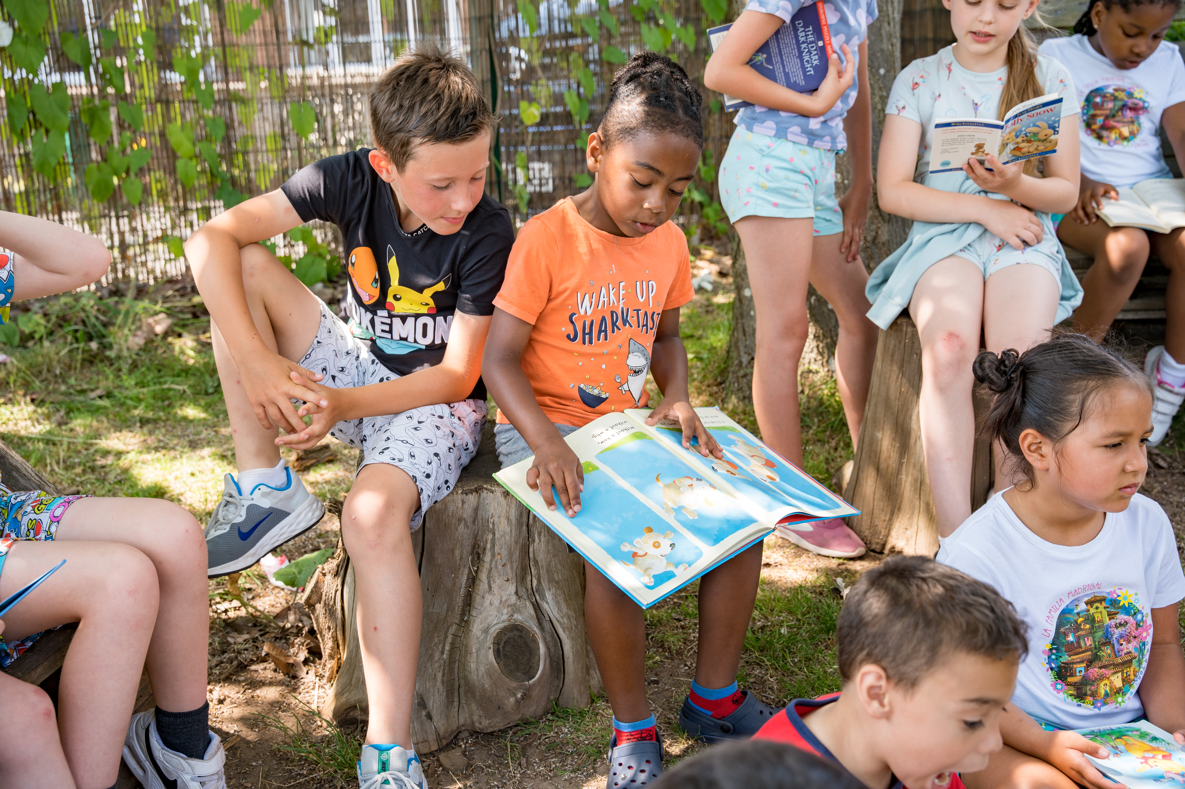
Reading for empathy
When you read a book, you are looking at someone else's feelings.
You can learn about people’s lives, listen to their thoughts and see from their perspectives.
The more we understand other people’s experiences, the closer we become as a community.
As well as learning about other people’s lives, reading helps others to understand your own experiences too.

Slide 13
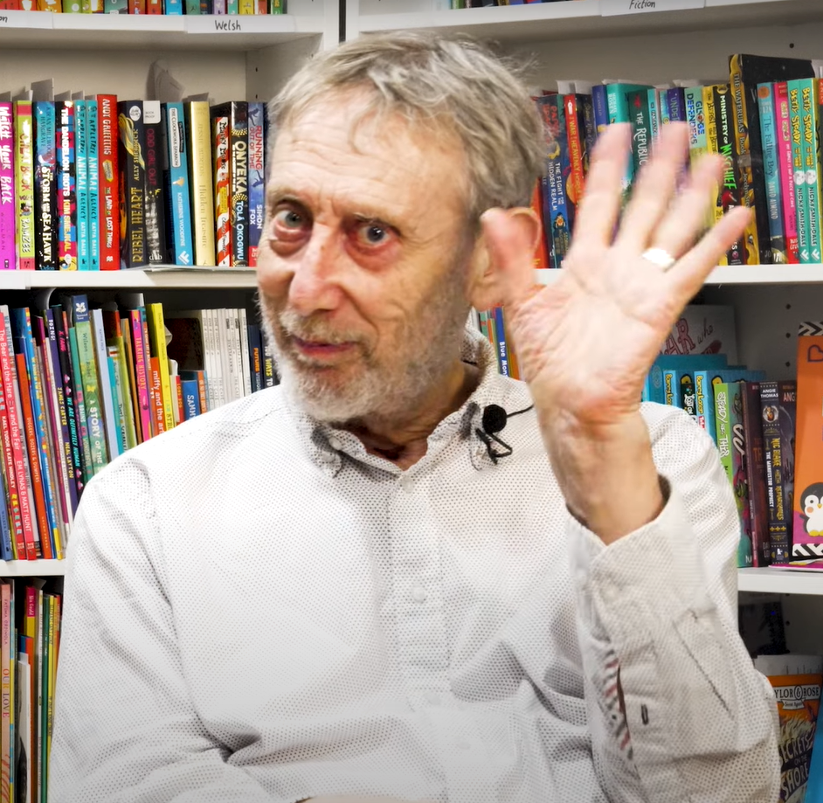
Enjoy your reading!
Visit our website for more information about our reading research.

