Slide 1


The book that represents me…

Slide 2

Learning Objectives
Click his picture to watch Benjamin Dean’s video and find out about his favourite books!
To recommend books that you have read, giving reasons for your choices
To identify and discuss themes in books
To write persuasively
Key words:
identity
representation
media

Slide 3
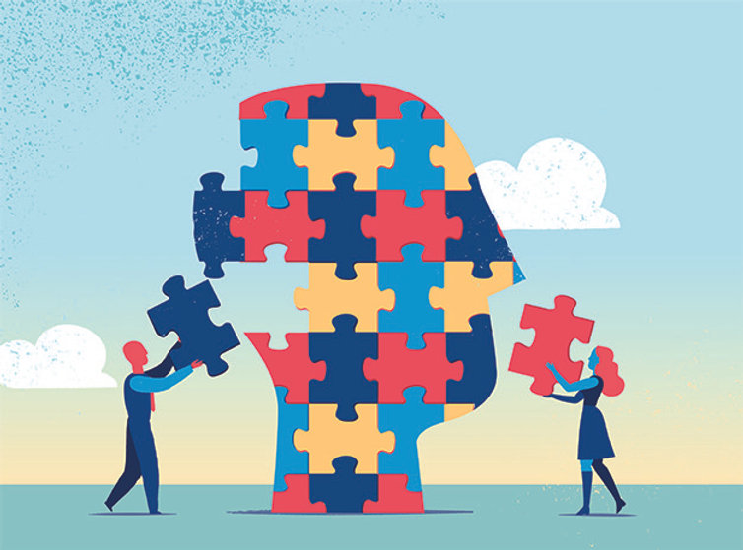
Identity and representation
Every person is unique and has their own individual identity.
Your identity is your own sense of who you are as a person and how you fit into the world.
Only you can know your true identity, nobody can label you as someone you are not.
Your identity includes all the things that make you unique: your experiences, your cultural background, your friends - even your sense of humour!

Slide 4

What is representation?
Representation is all about how different people’s identities are presented in books, television programmes, films and other forms of media.
Can you think of any other forms of media?
Media includes all the different ways of communicating ideas on a large scale.

Slide 5
Why is representation important?
Seeing parts of your own identity represented can help you build a sense of community and belonging.
Reading about characters who have had similar experiences to you can help make sense of the world and feel you are not alone.
Books can be a great way to share parts of your identity with your friends and family.
Books which represent a wide range of identities can help you understand more about other people’s lives.

Slide 6
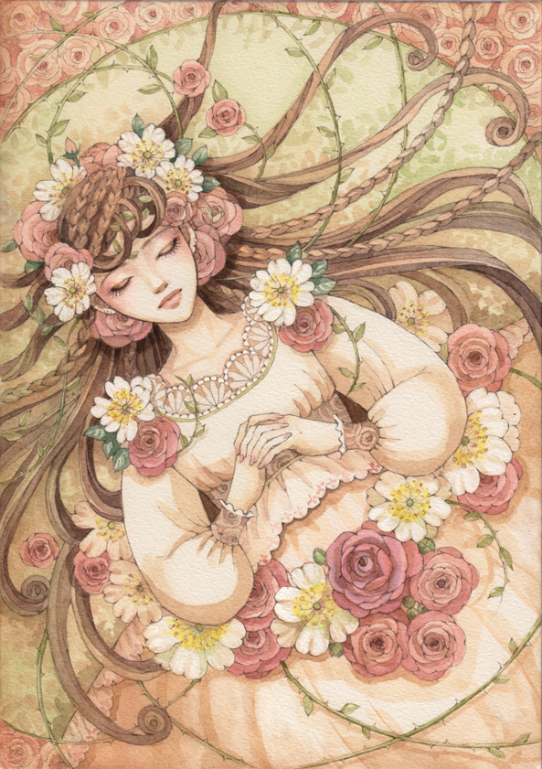
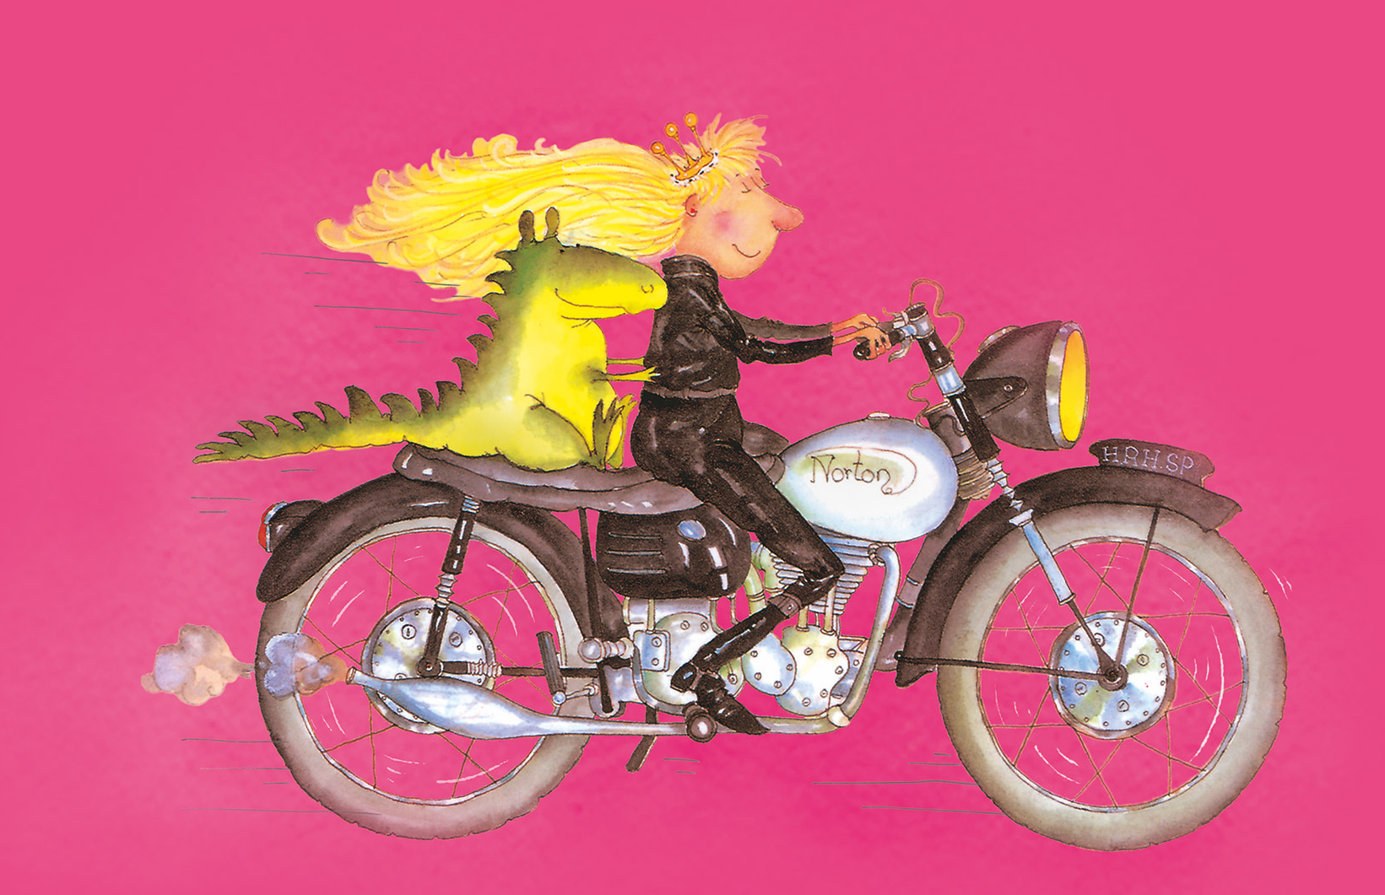
The way that people are represented in the media can influence the way people think about themselves and others in the real world.
Look at these illustrations of princesses from books.
How could each one affect your opinion of women and girls?

Slide 7


Different parts of your identity can be represented in the books you read.
They might represent where you live...
In a city
Or in the countryside

Slide 8


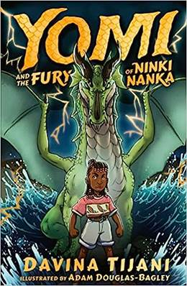

A book might represent an aspect of your cultural background, religion or ethnicity.

Slide 9




A book might represent important experiences you have had that have added to your identity.
Coping with serious illness
Dealing with social media
Moving home or country
Losing a family member

Slide 10



Characters in books might represent values or attitudes that are important to your identity.
Friendship and a sense of humour
Environmental themes
Wanting to make a political change

Slide 11
Which book represents you?
Which book do you think best represents a part of your unique identity?
Write about your chosen book and share which part of your identity it represents and how it makes you feel.
Really spend some time thinking about a book that has reached out to you in a powerful way.
Your review should include a short summary of the plot, and it should persuade other people to read it and explain why they might enjoy it or find it inspiring.

Slide 12

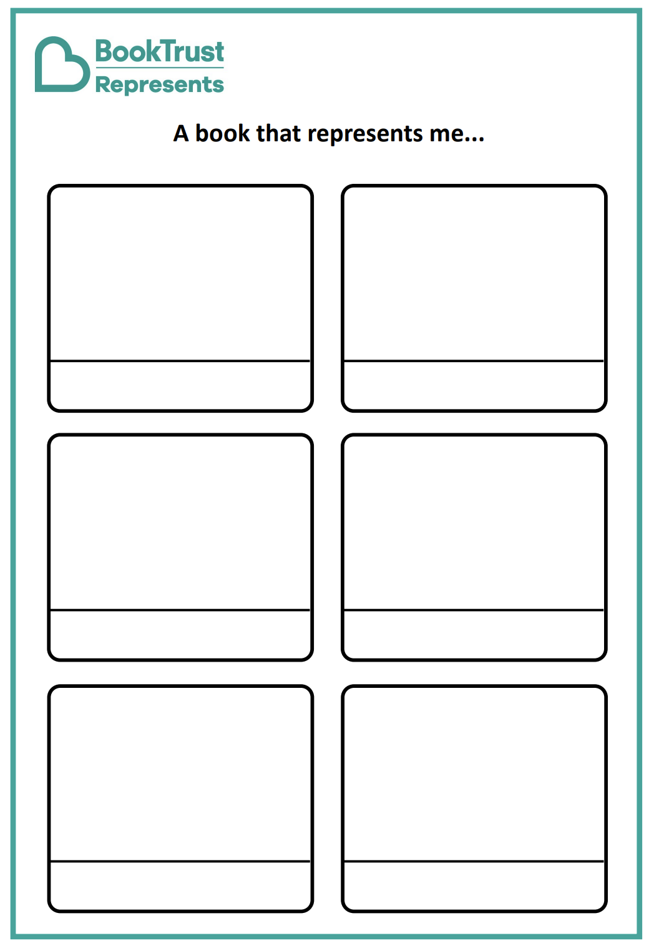
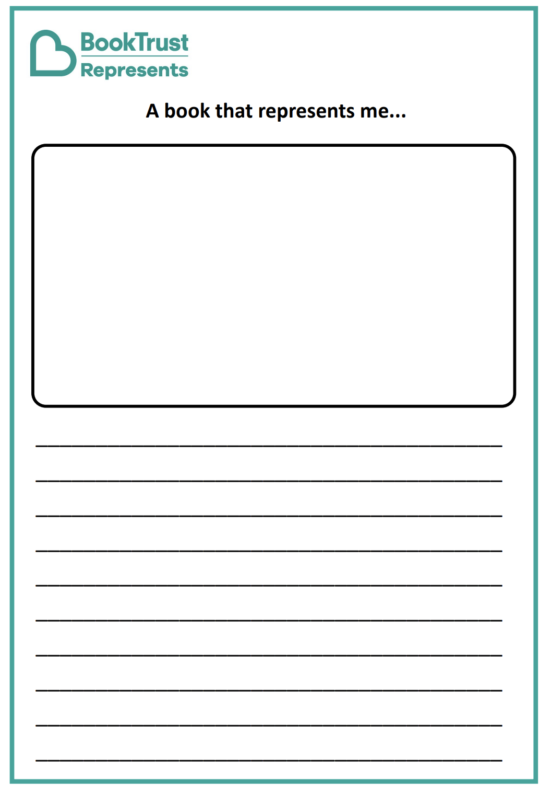

Which book represents you?
Remember to include:
- Your name
- The book title
- A summary of what happens
- Persuade other people to read it
- How it represents part of your identity
Key words:
identity
representation
media

