Slide 1
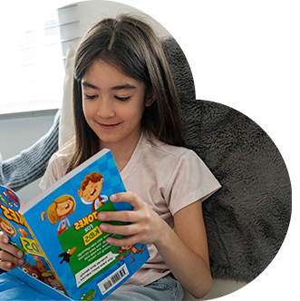
Bringing the magic of reading and numeracy to pupil premium and vulnerable learners age 3-13

Slide 2
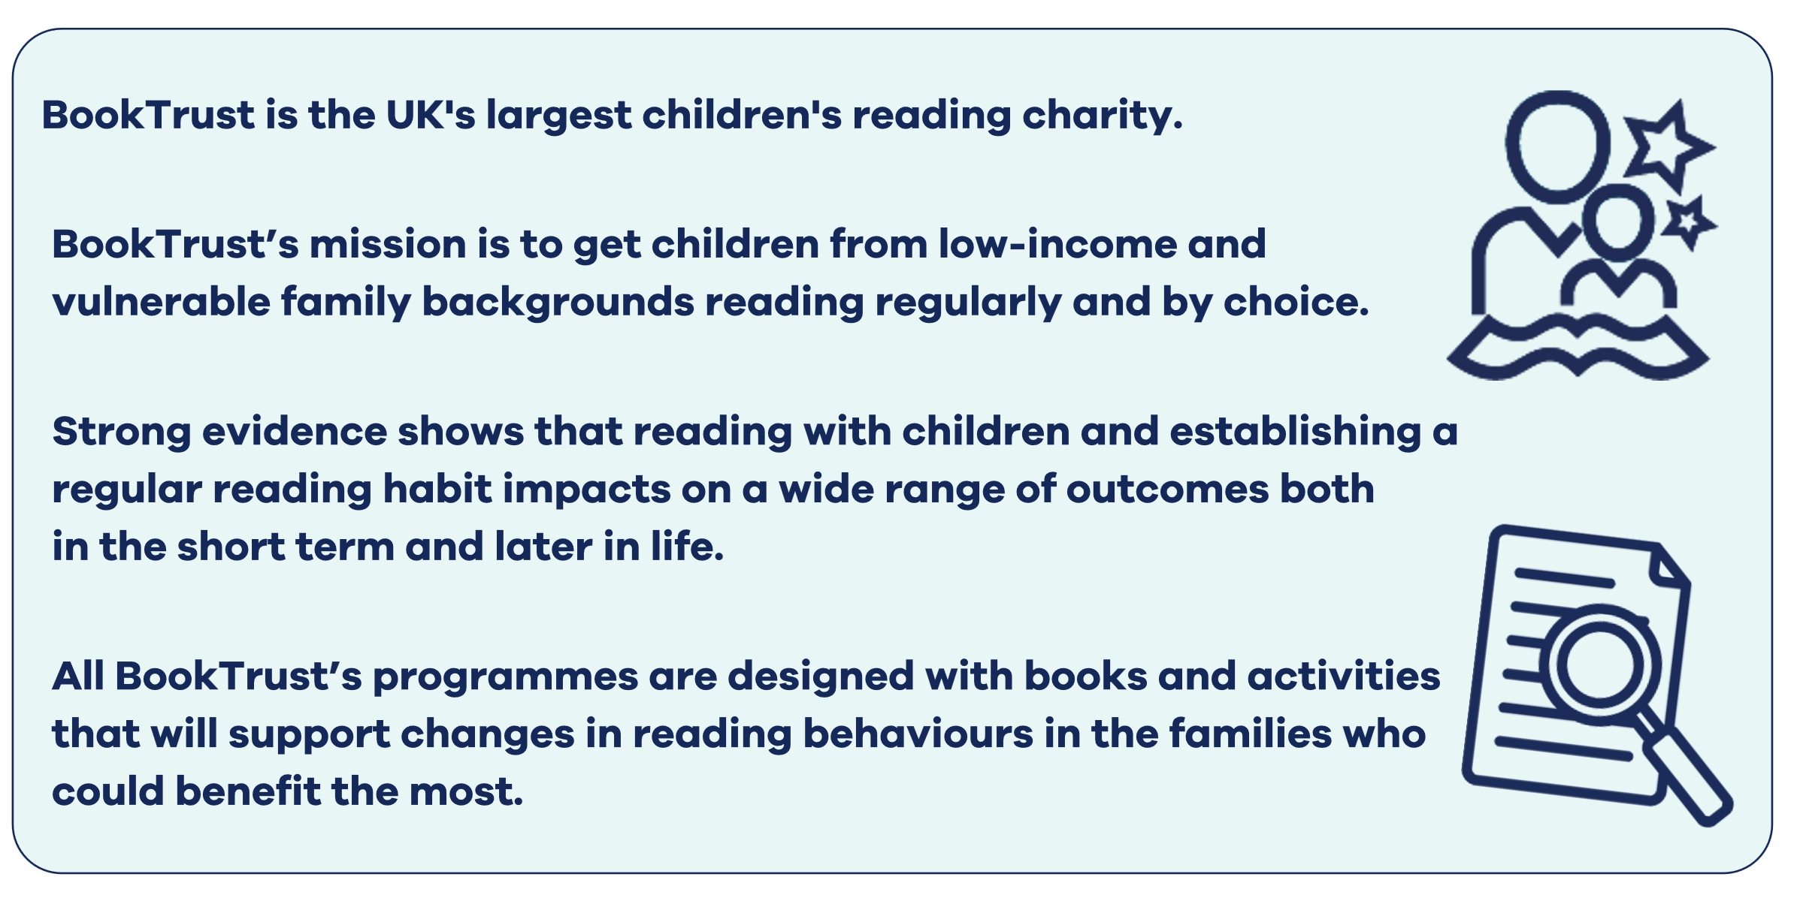
BookTrust – getting children reading from their earliest days
booktrust.org.uk/letterbox-club

Slide 3

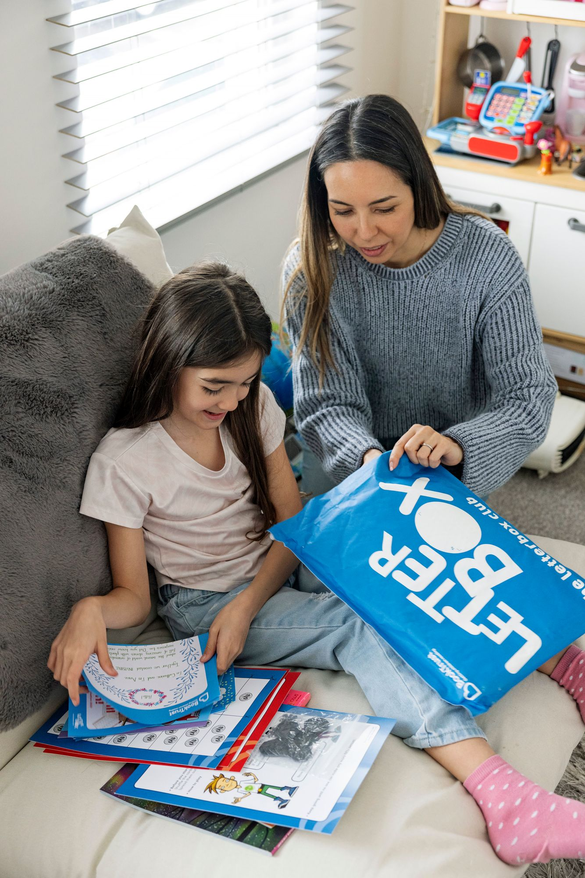
Introducing Letterbox Club Tried and trusted by thousands of children
As one of the flagship programmes at BookTrust, Letterbox Club has, for over 20 years, continued to be enjoyed by thousands of children along with their parents, carers and teachers to get children reading, wherever they are.
booktrust.org.uk/letterbox-club

Slide 4

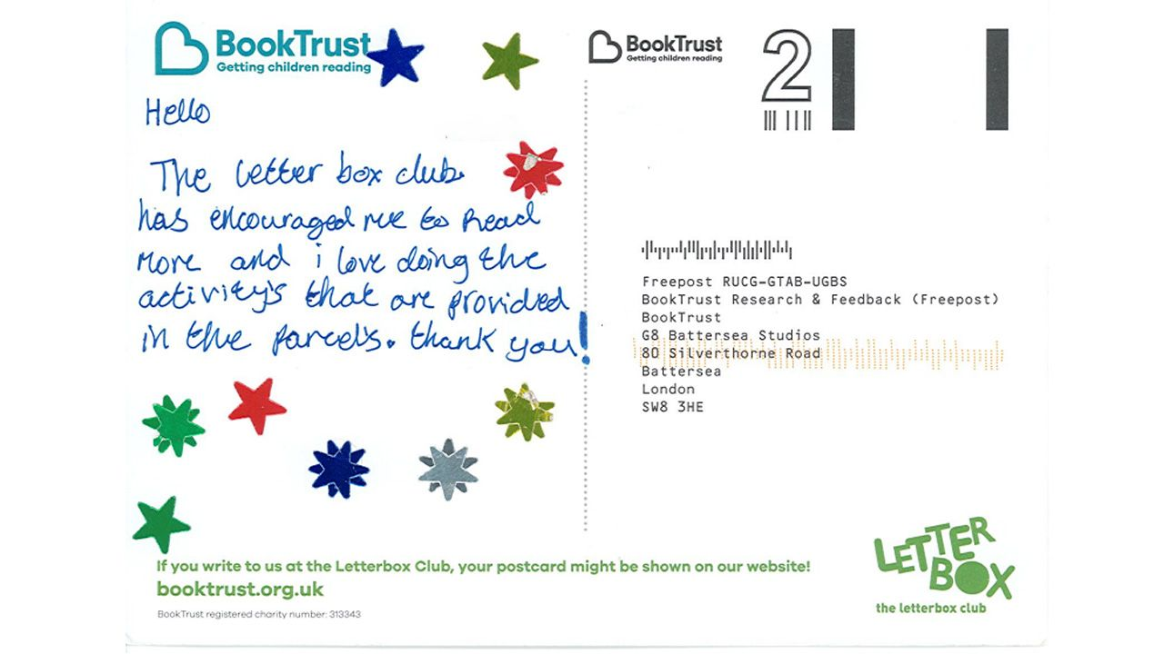
What is Letterbox Club?
Parcels of books, maths games and learning resources are carefully chosen, and thoughtfully organised and presented, to have an impact on children's reading habits and, a positive effect on their emotional wellbeing.
booktrust.org.uk/letterbox-club

Slide 5
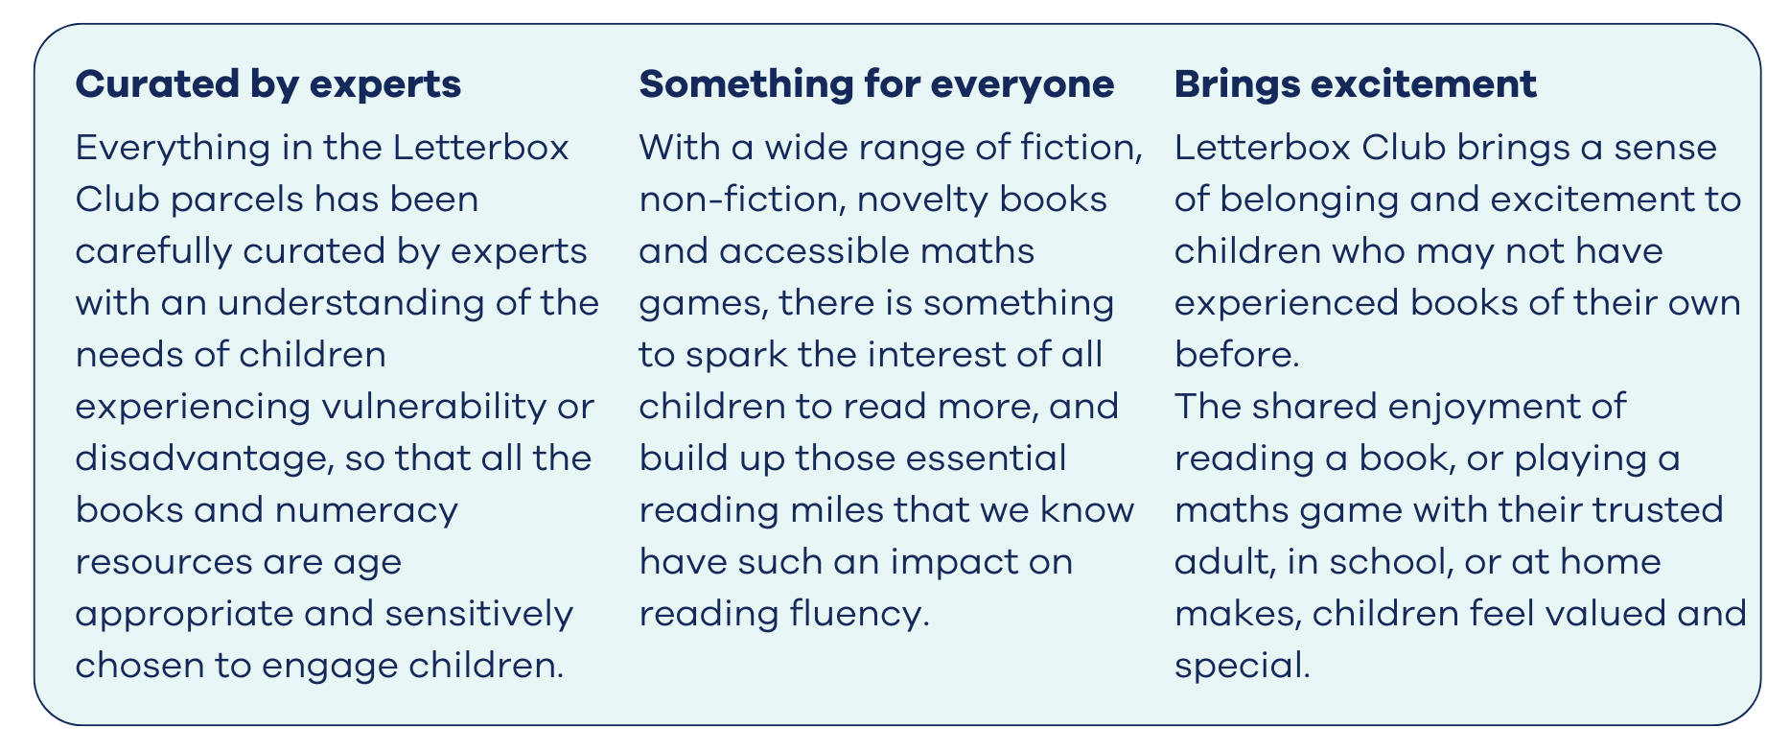
How?
booktrust.org.uk/letterbox-club

Slide 6


“It's about their own
self-esteem and self-confidence that they have something that's special for them."
Maggie Faulkner, Hounslow Town Primary school
booktrust.org.uk/letterbox-club

Slide 7
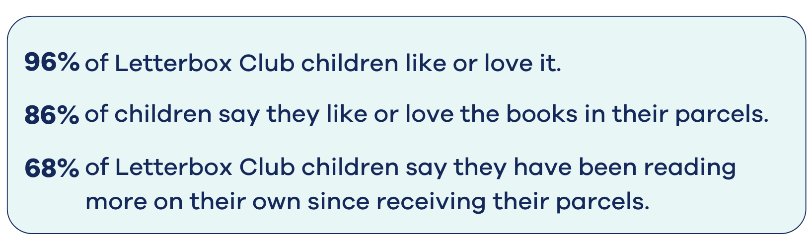
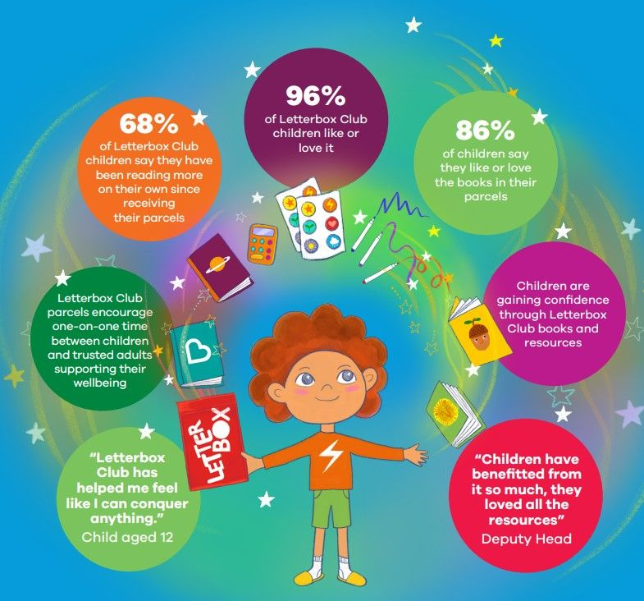
What does the research show? Our annual survey findings report:
Read the full impact report here
booktrust.org.uk/letterbox-club

Slide 8

Six different parcel sets to choose from to support children…
Purple - in the EYFS (ages 3-5)​
Orange - in Year 1, to follow them into Year 2 (ages 5-7)​
​
Yellow and Blue – in Year 3, to follow them into Year 4 (ages 7-9). We have two parcel sets across this age band, with Yellow for emergent readers and Blue for independent readers.
Red - in Year 5, to follow them into Year 6 (ages 9-11)​
Green - in Year 7, to follow them into Year 8 (ages 11-13)
All ages and year groups are for guidance only and parcels can be chosen to suit a child’s individual abilities and circumstances.

Slide 9
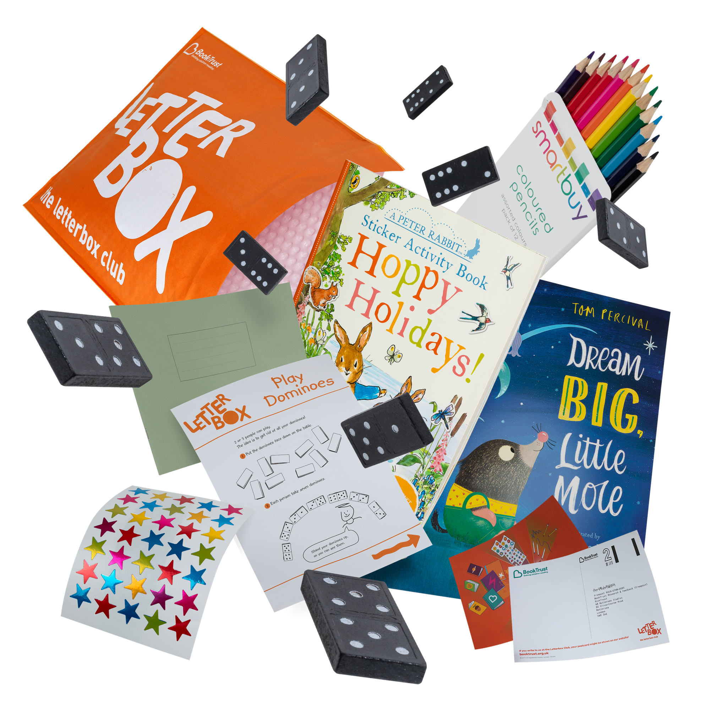
More than just a parcel of books…
1-3 reading books from a range of different genres, selected by our independent panel of experts to capture children’s interest and imagination. ​
An age-appropriate maths game and resources to develop number confidence and engage with numeracy in an accessible way, that builds self-regulation, perseverance and problem-solving strategies. ​
A letter from the book author describing the chosen book or sharing ideas and experiences to help children feel special and valued. ​
Additional quality resources such as bookmarks, pens, notepads and calculators, enticing children to engage in the parcels and support independent learning in class or at home. ​
A postcard from the Letterbox Club team providing a space for children to share their thoughts (and practise their writing!).
booktrust.org.uk/letterbox-club

Slide 10
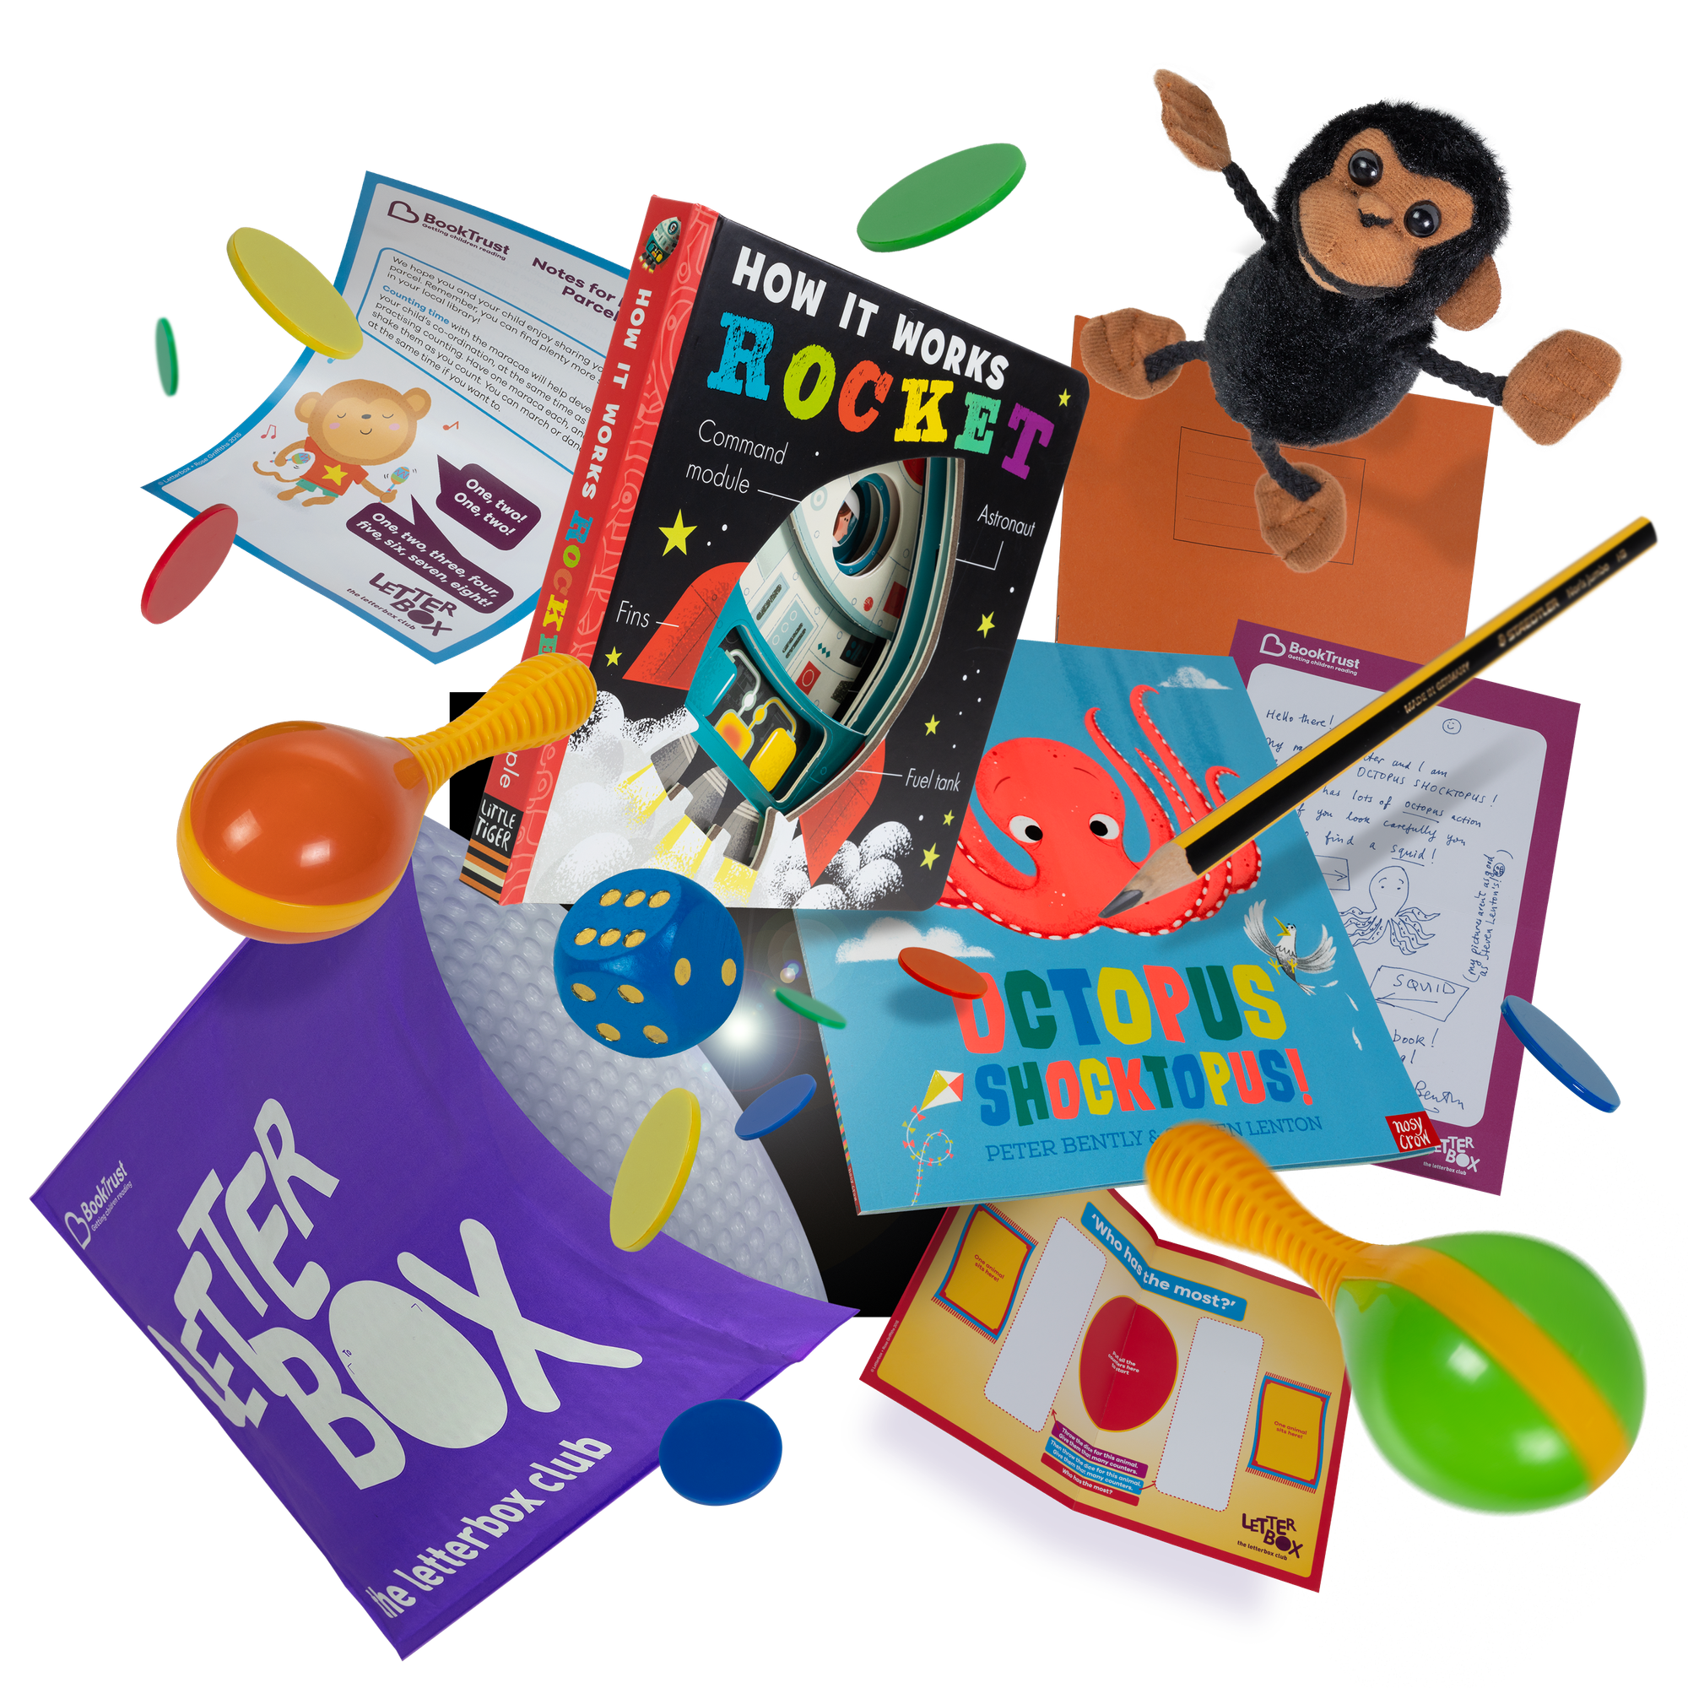
Take a look inside…
Take a sneak peak inside a Letterbox club parcel, here you will see examples of what you might find
booktrust.org.uk/letterbox-club

Slide 11
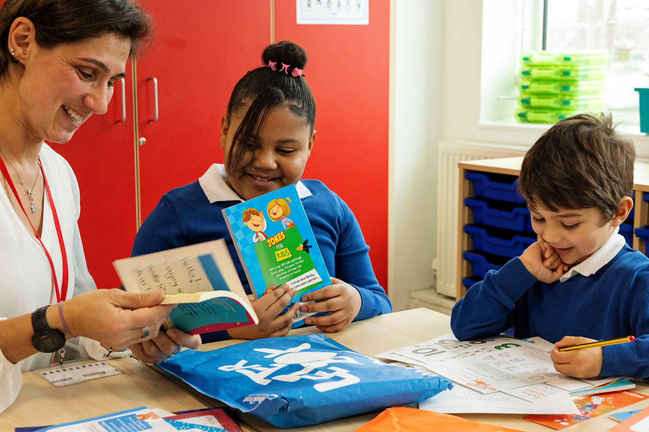
How are the books selected?
Everything you’ll find in the Letterbox Club parcels has been carefully curated by experts with an understanding of the needs of children experiencing vulnerability or disadvantage. ​
Books are selected every year by an independent panel of experts, including virtual school practitioners, head teachers, teachers, foster carers, and young people who are care experienced. ​
booktrust.org.uk/letterbox-club

Slide 12
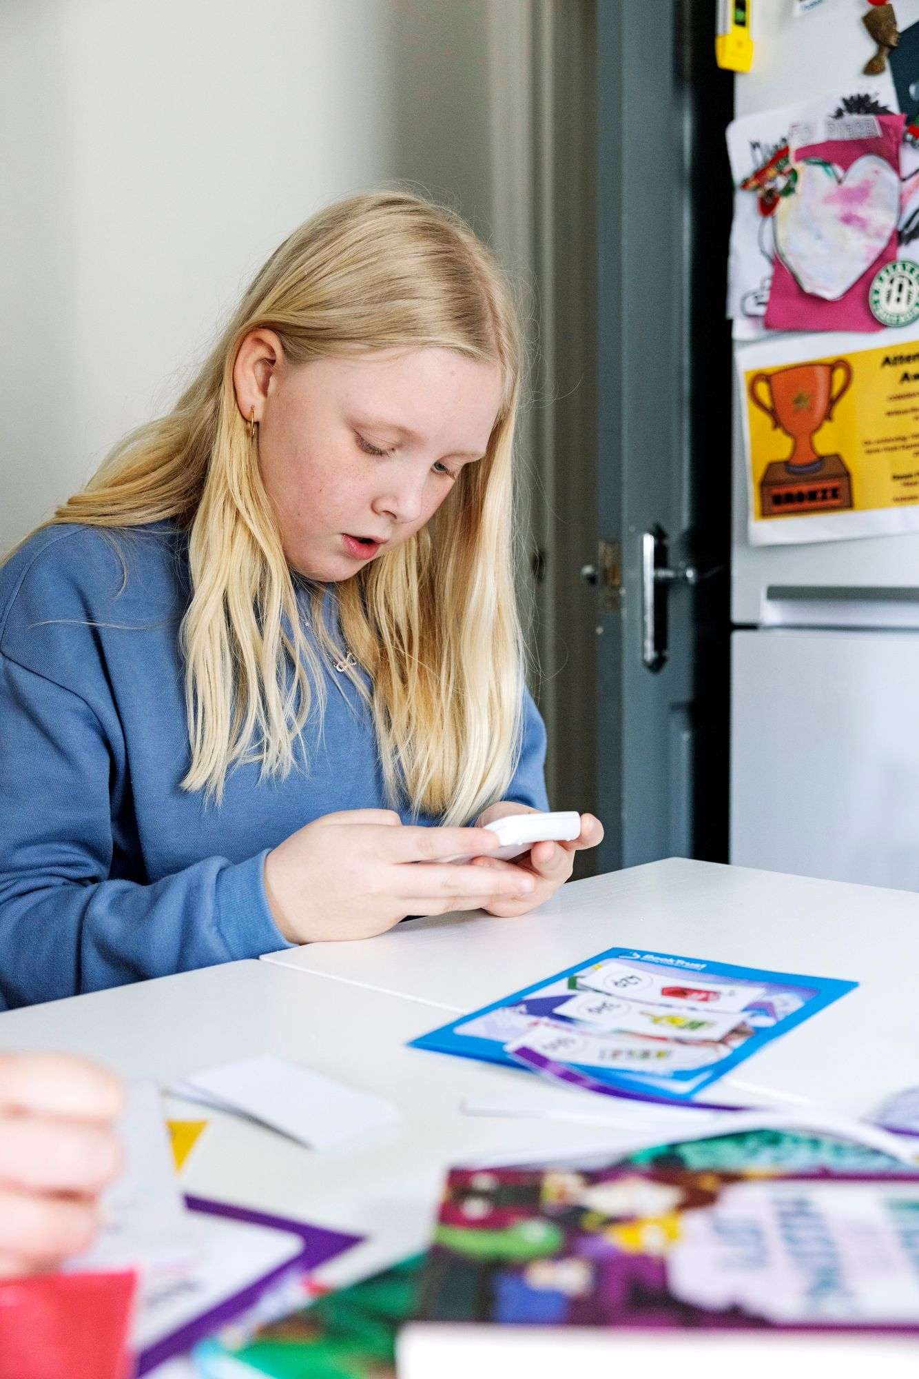
The value of maths games for vulnerable learners
Inside every Letterbox Club parcel, you'll also find an age-appropriate maths game and resources designed for children to play independently, or with others, to develop number confidence.​
​
Why?​
​
Engaging with numeracy in an accessible way builds self-regulation, perseverance and collaboration strategies​
Maths games provide a structure and a process for children to engage in collaborative problem-solving to helping them to reach a goal. ​
Games can build on children’s mathematics knowledge, generate repeated practice in a motivating context, and give children and adults an opportunity to discuss strategies and ideas. ​
Maths games support children to learn how to approach failure with a growth mindset, as games provide safe opportunities to take risks. ​
Read more here
booktrust.org.uk/letterbox-club

Slide 13

Inspiring children for the future…
“For Looked After Children, books can open up their world. They can help explain things, build empathy, or help children to understand different situations. We often hear that books make children feel calmer and children themselves say the Letterbox Club is amazing and the books are lovely and inspiring.”
Niki Freckelton, Officer for Children Looked After, Virtual School, Southampton City Council
“[Letterbox Club] makes you spend time together. It gives you that quiet space where you can just sit and be with a book and not have anything else going on.”
Foster carer
"The work that BookTrust puts into curating the Letterbox Club packs is so valuable for the wider care of that child's development … As well as engaging them with a love of reading, it's about inspiring them to be excited about their futures and where they want to go.”
Ruth Dunmore, Deputy Head Teacher
booktrust.org.uk/letterbox-club

Slide 14
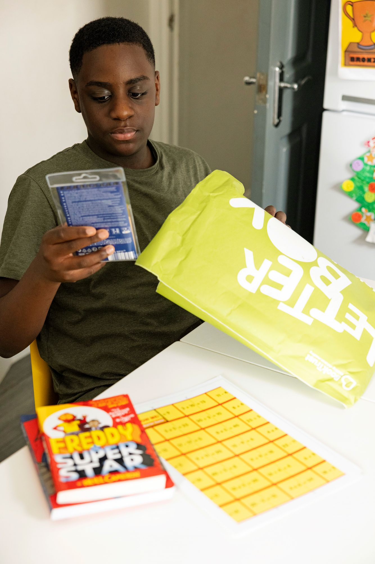
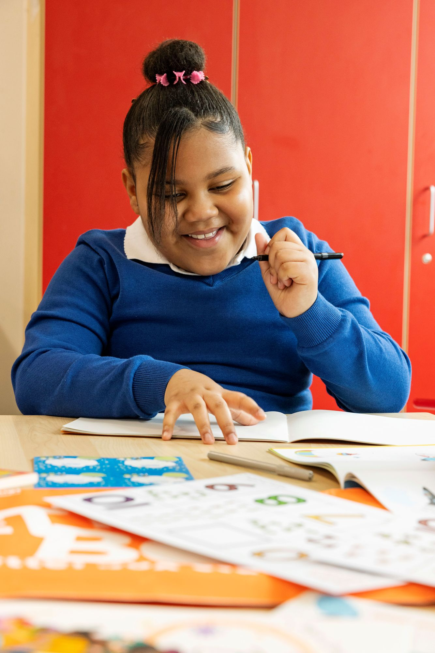
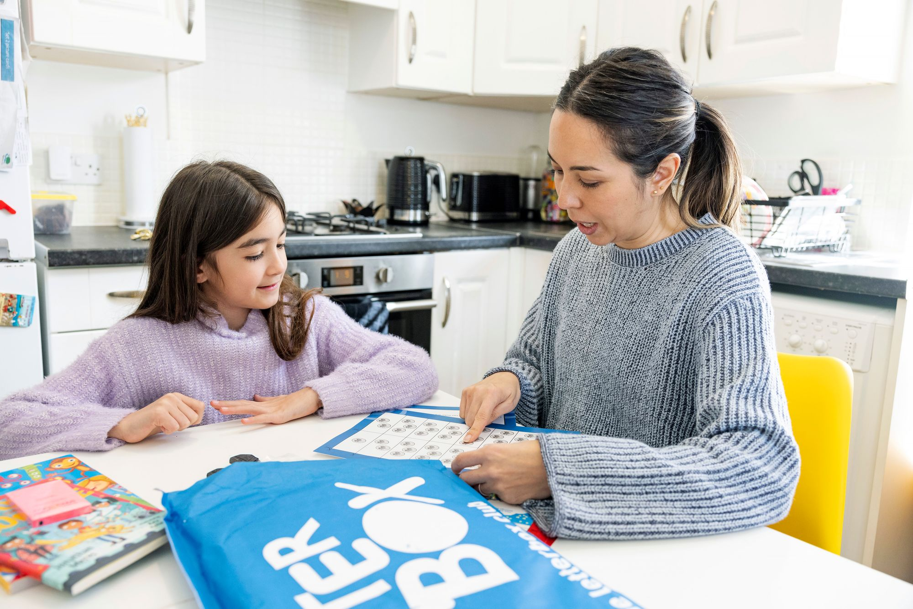
Find out more at... booktrust.org.uk/letterbox-club

