Slide 1
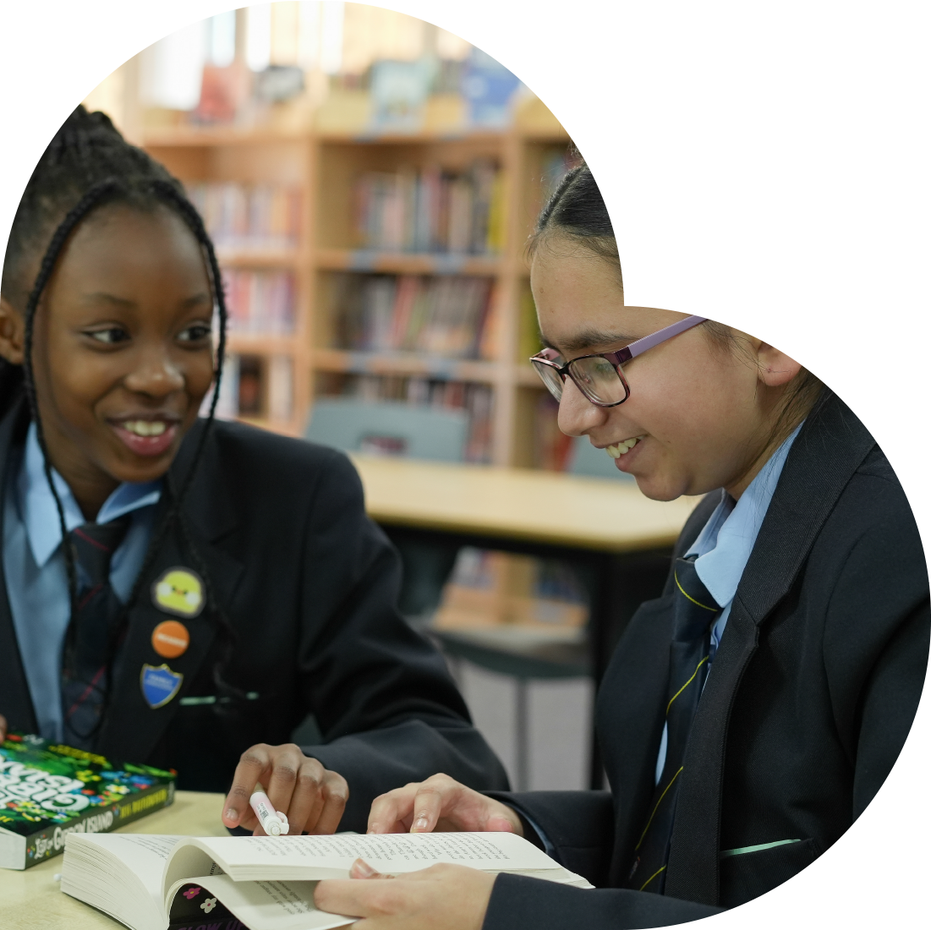

Slide 2
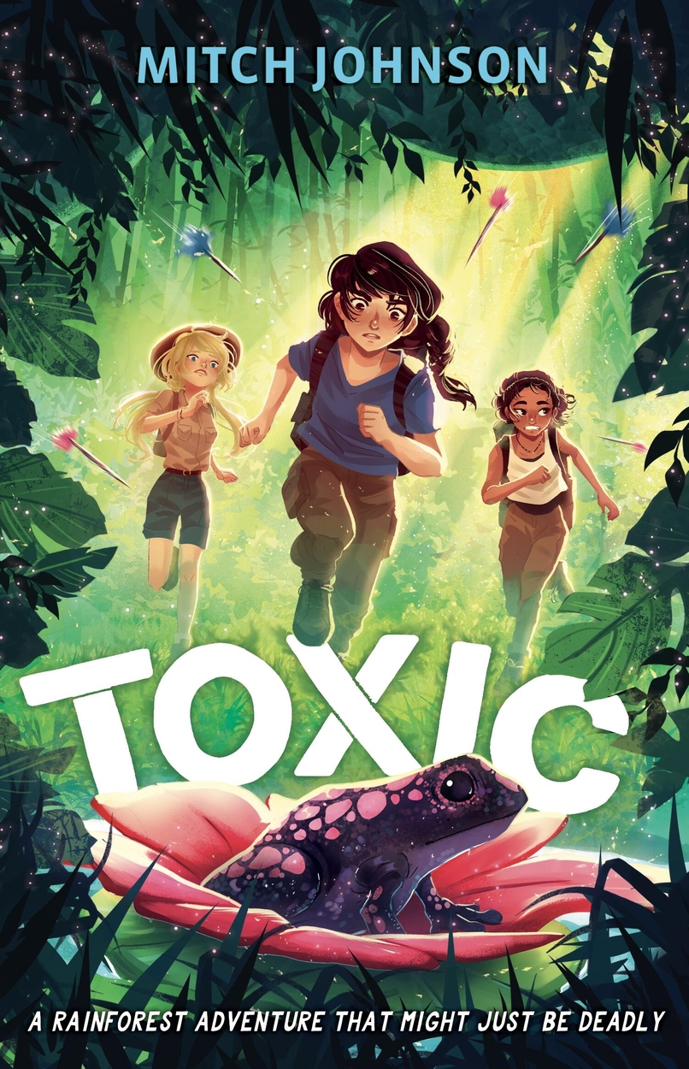
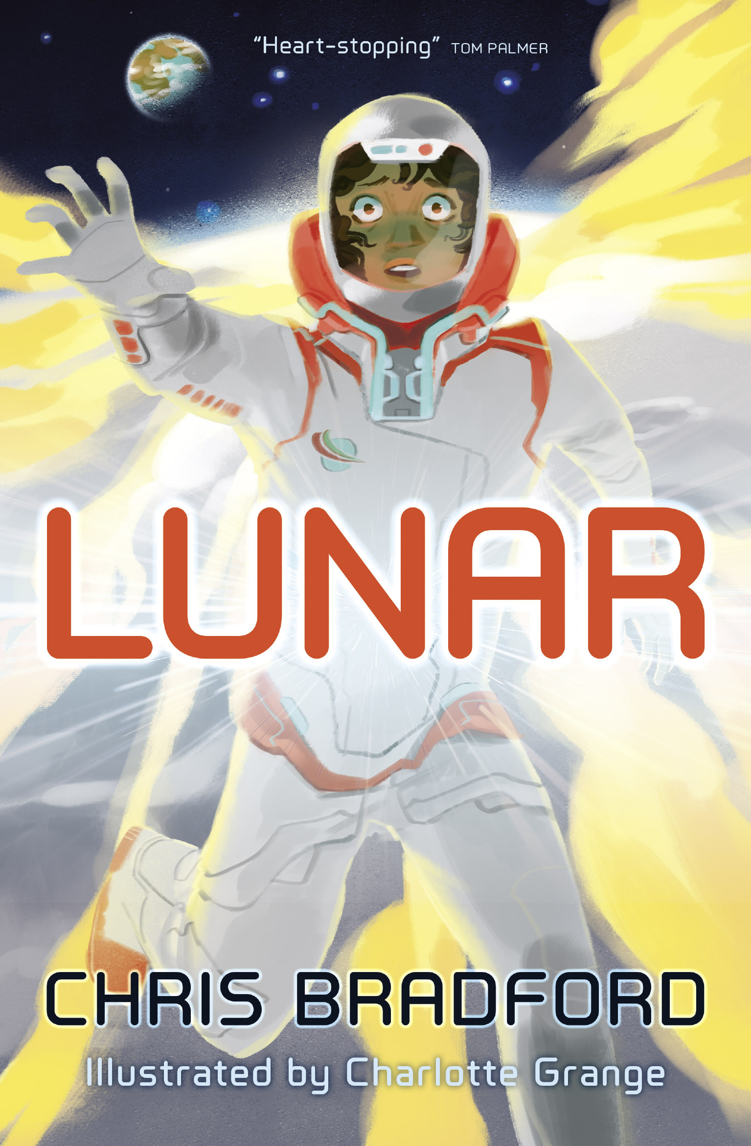
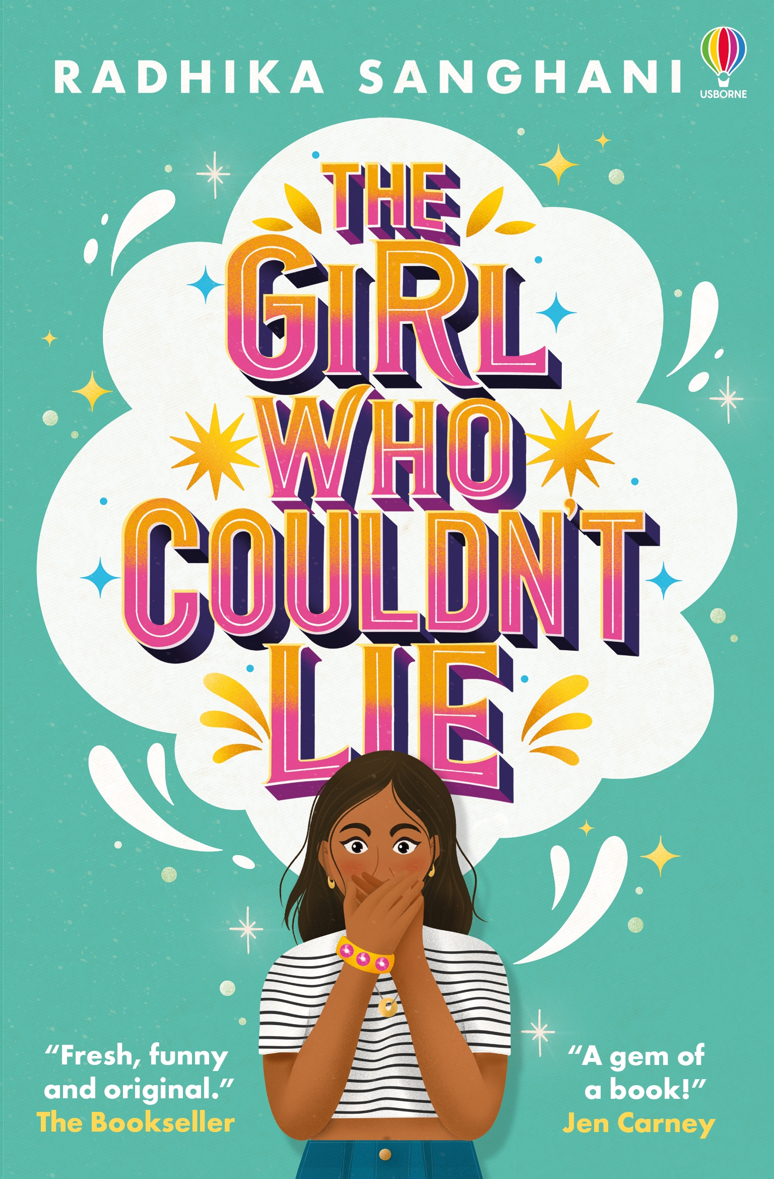
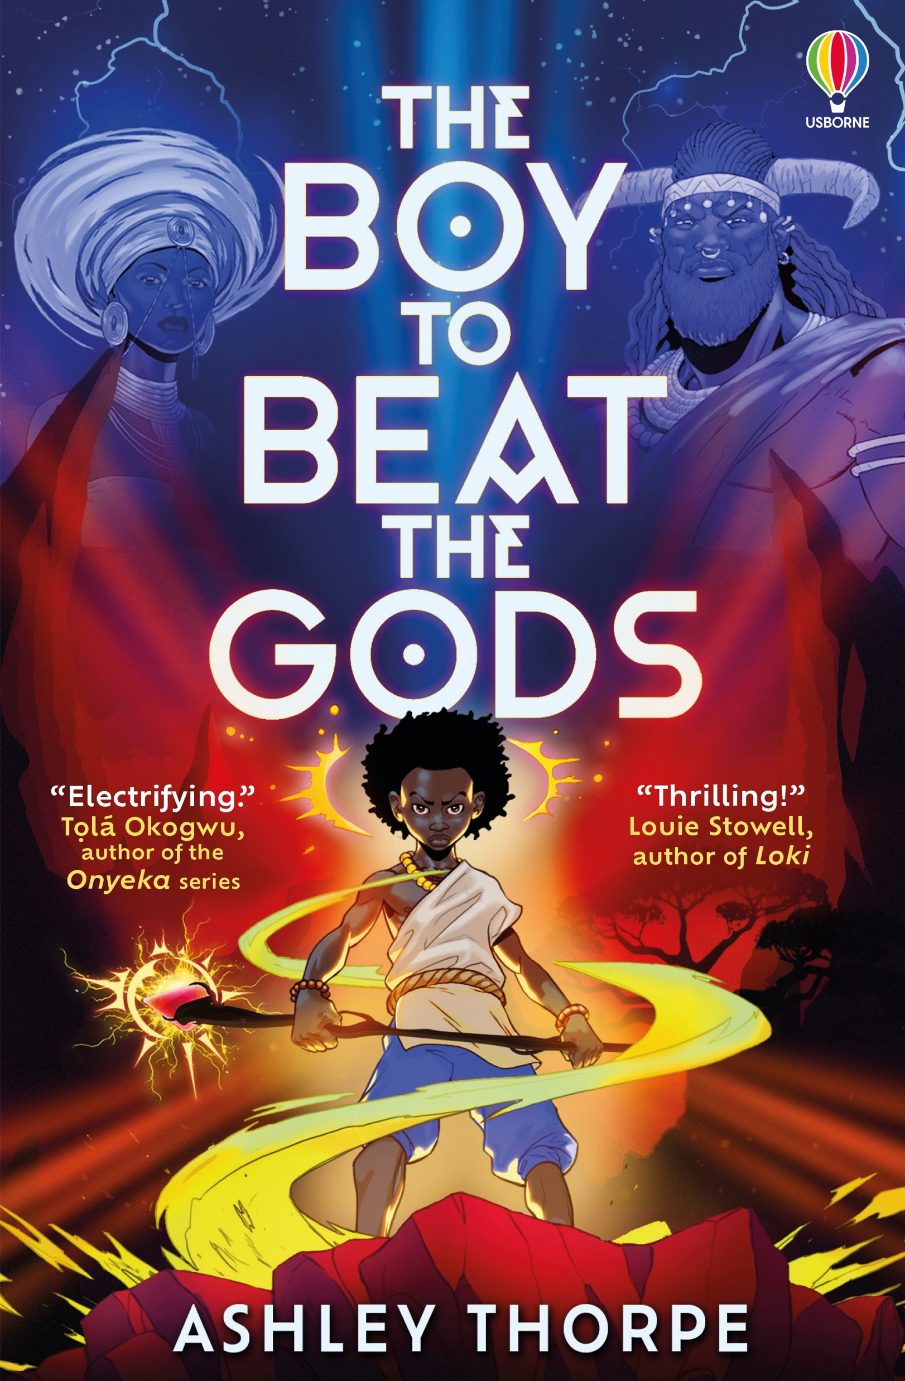
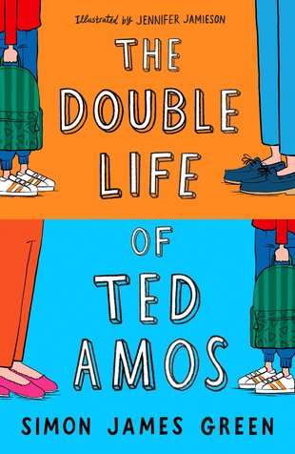
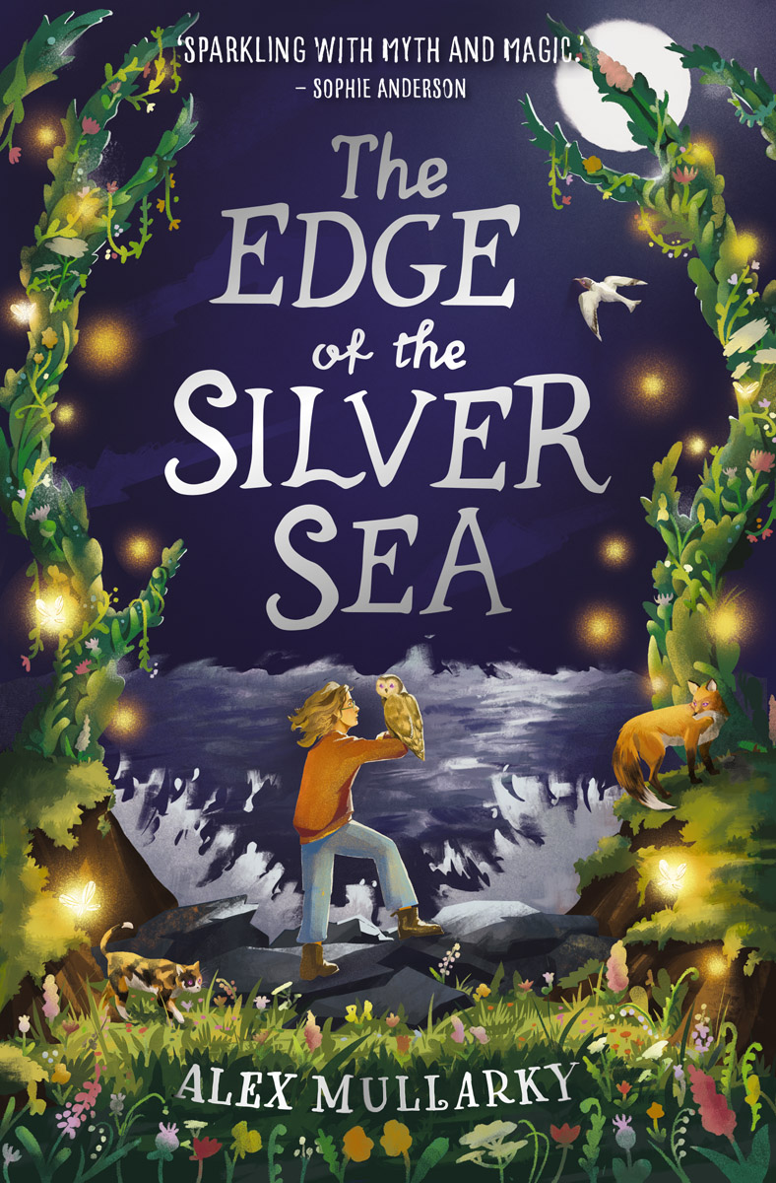
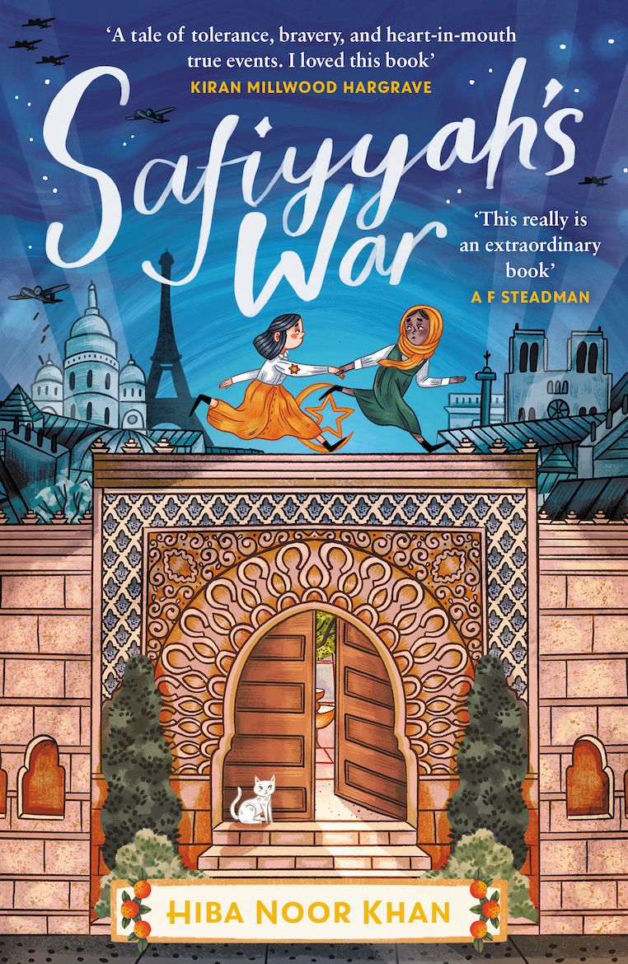
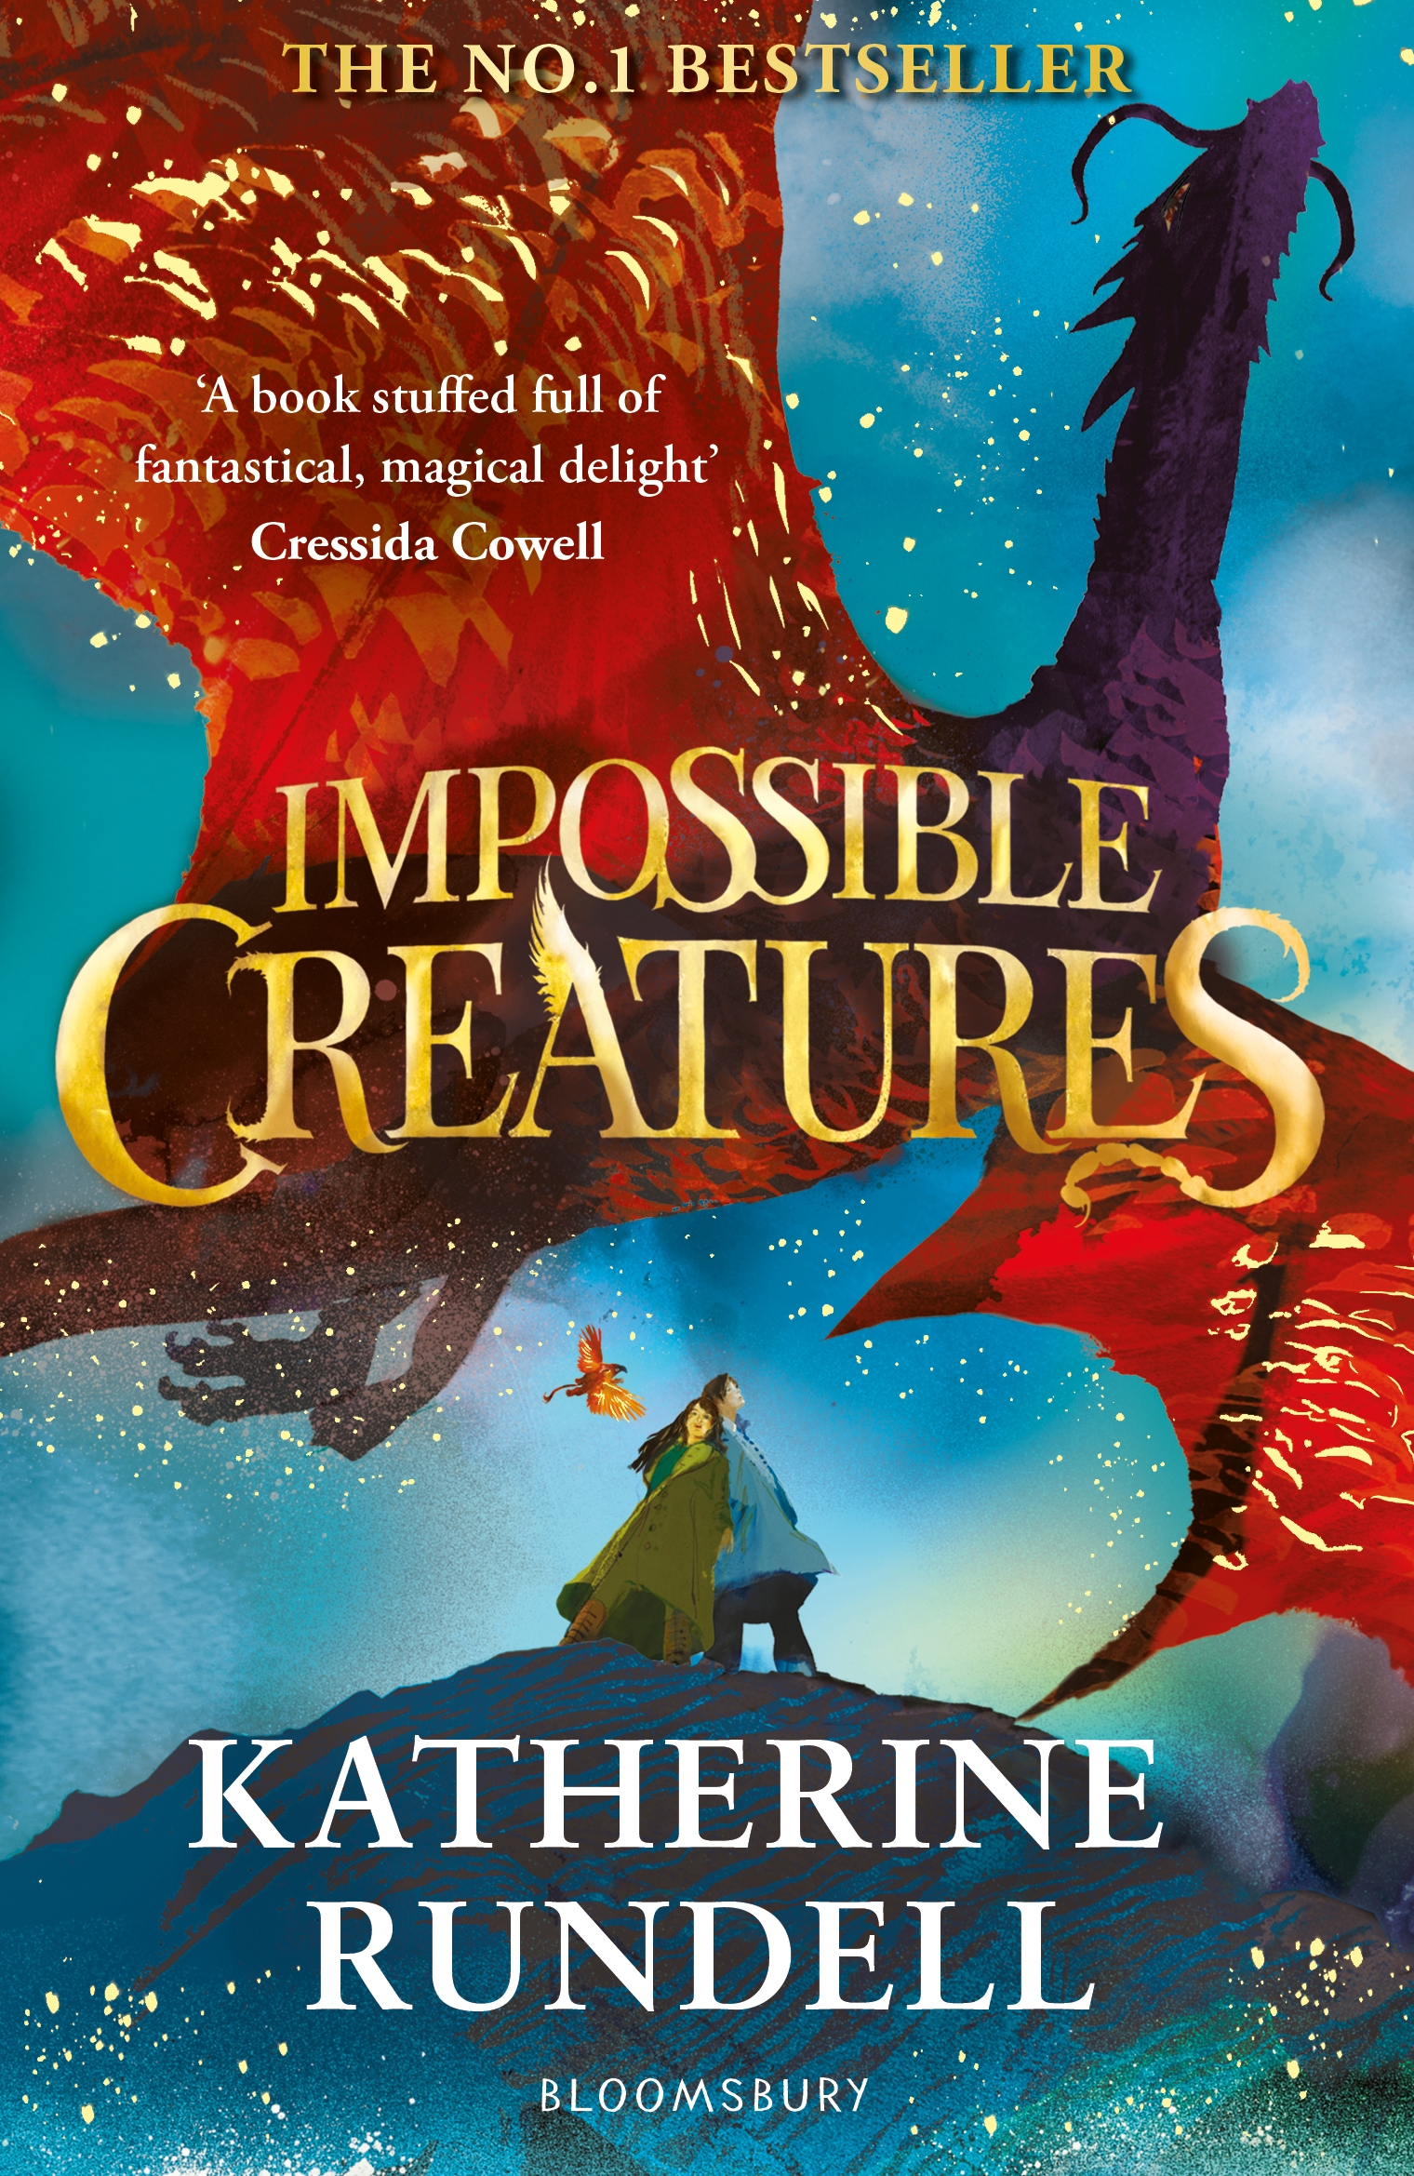
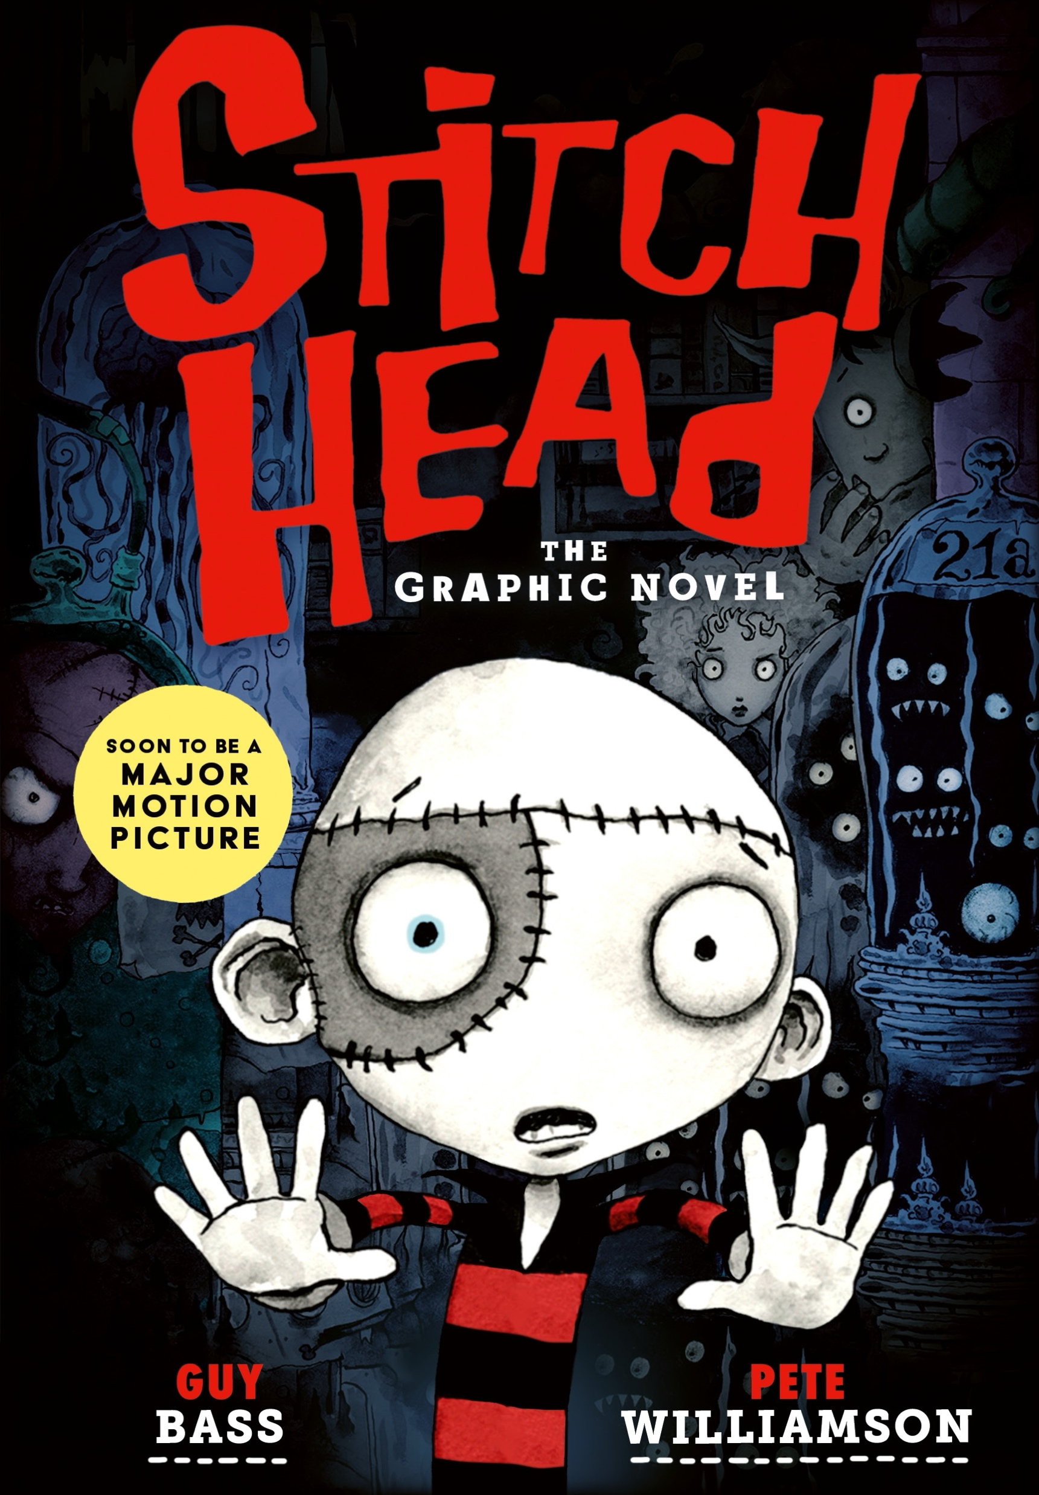
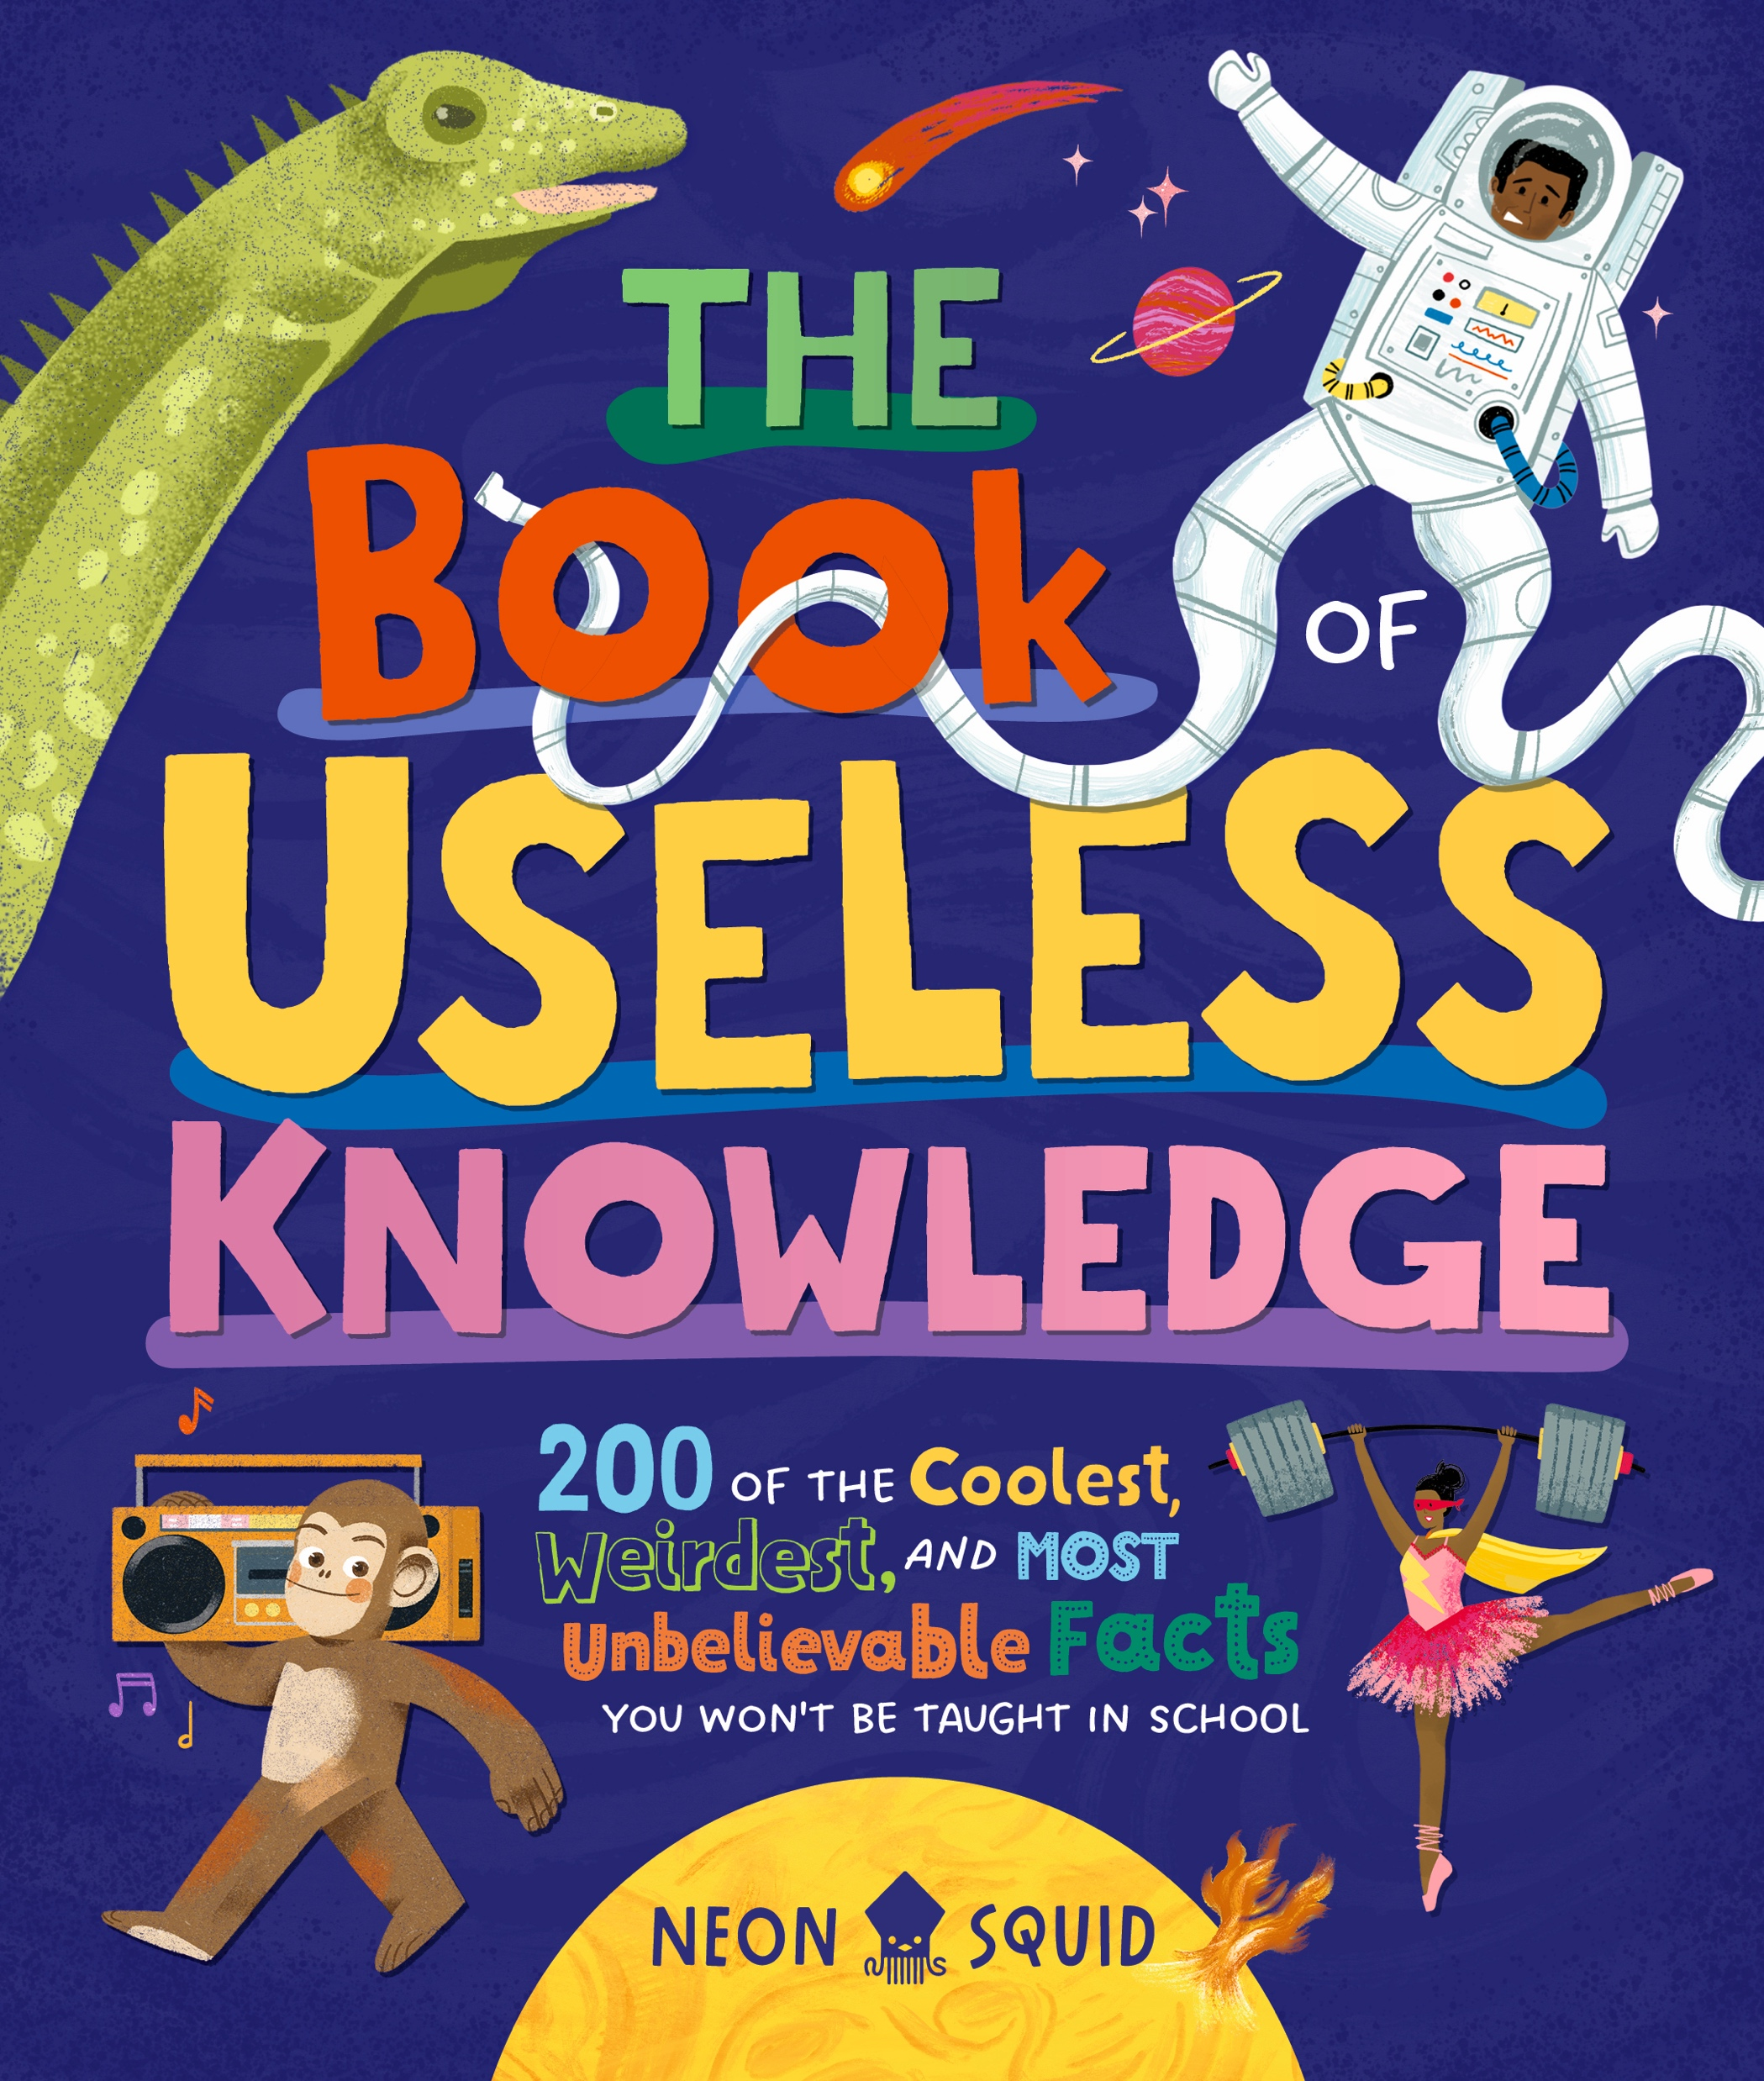
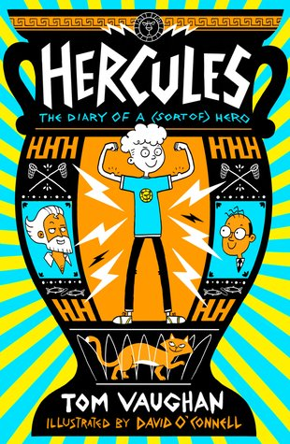
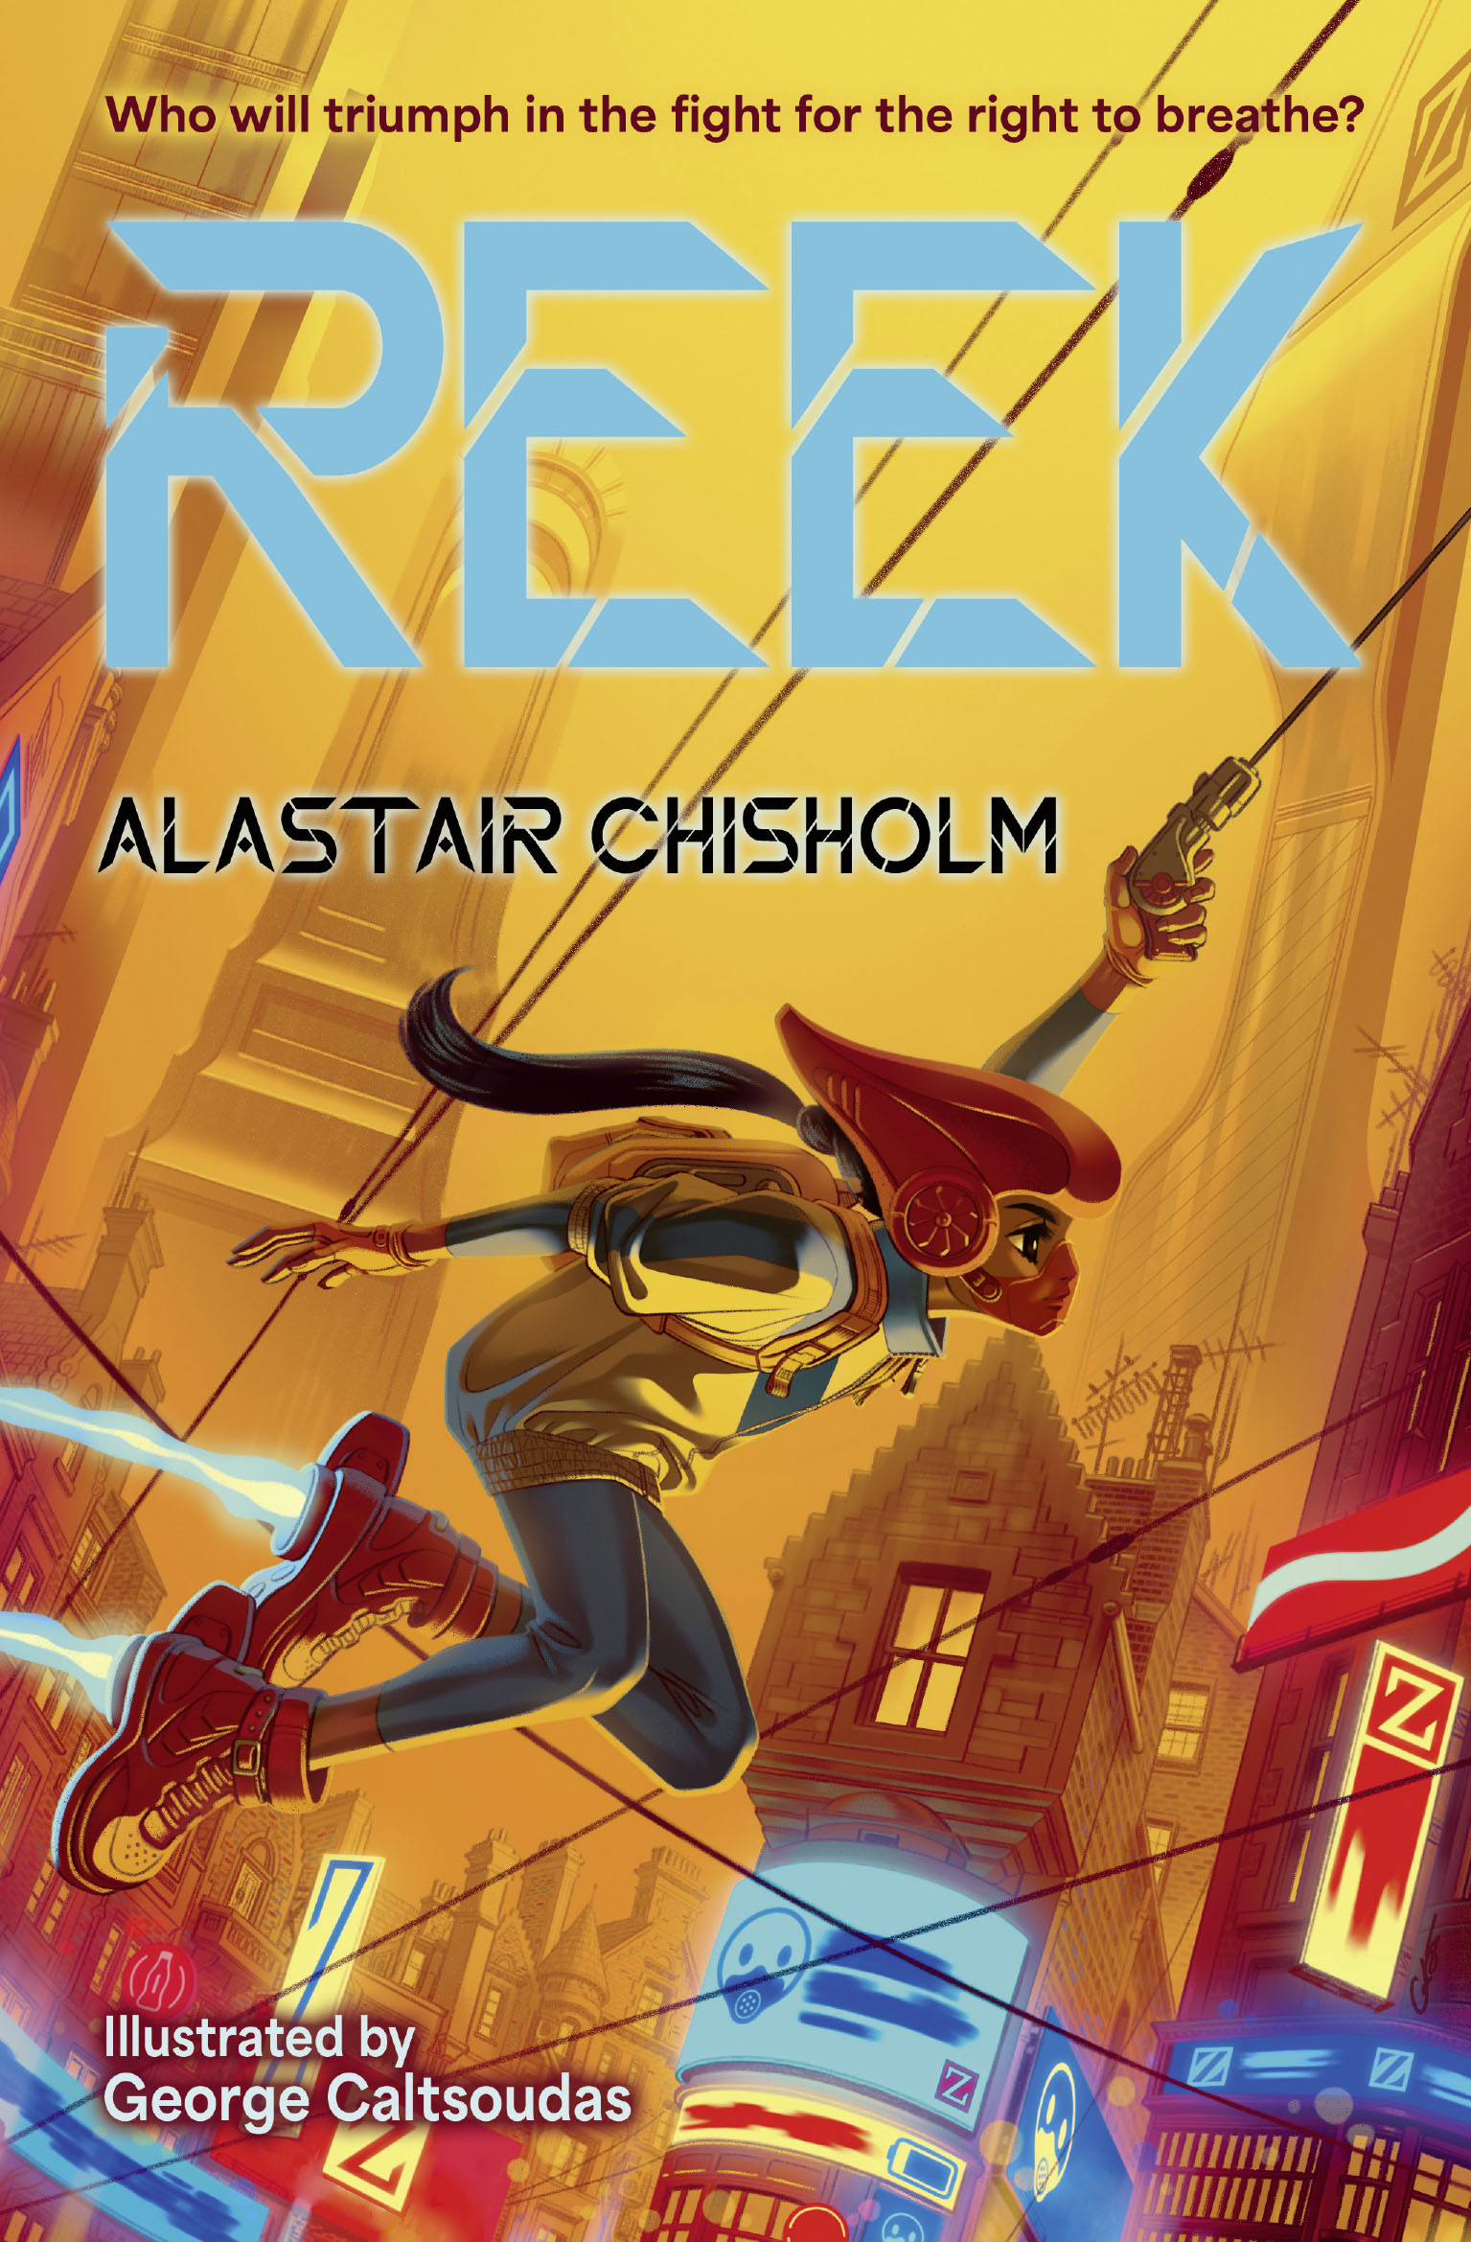
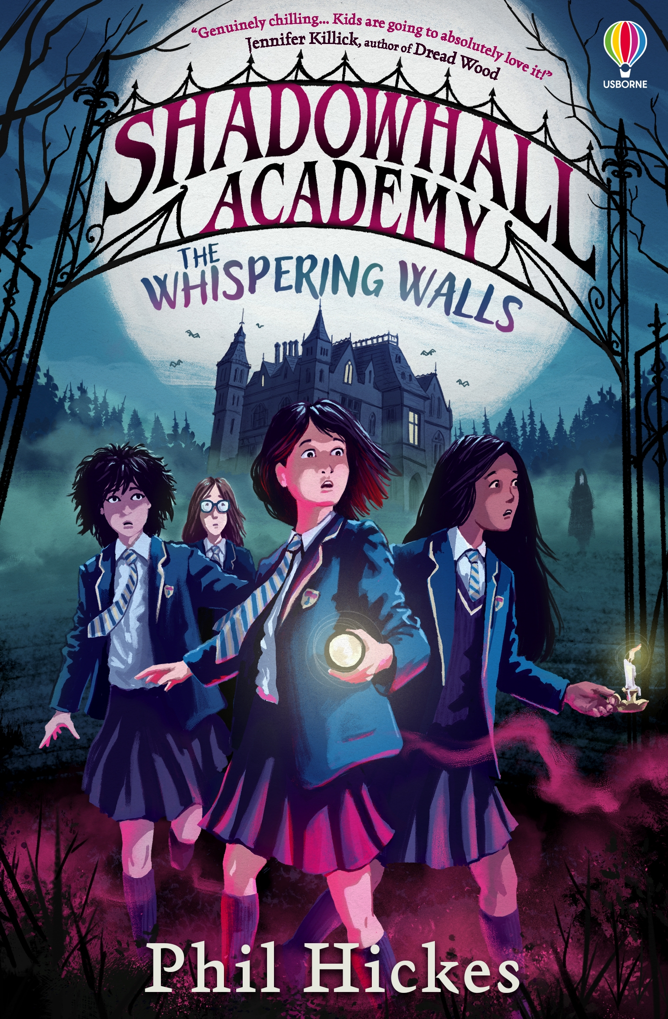
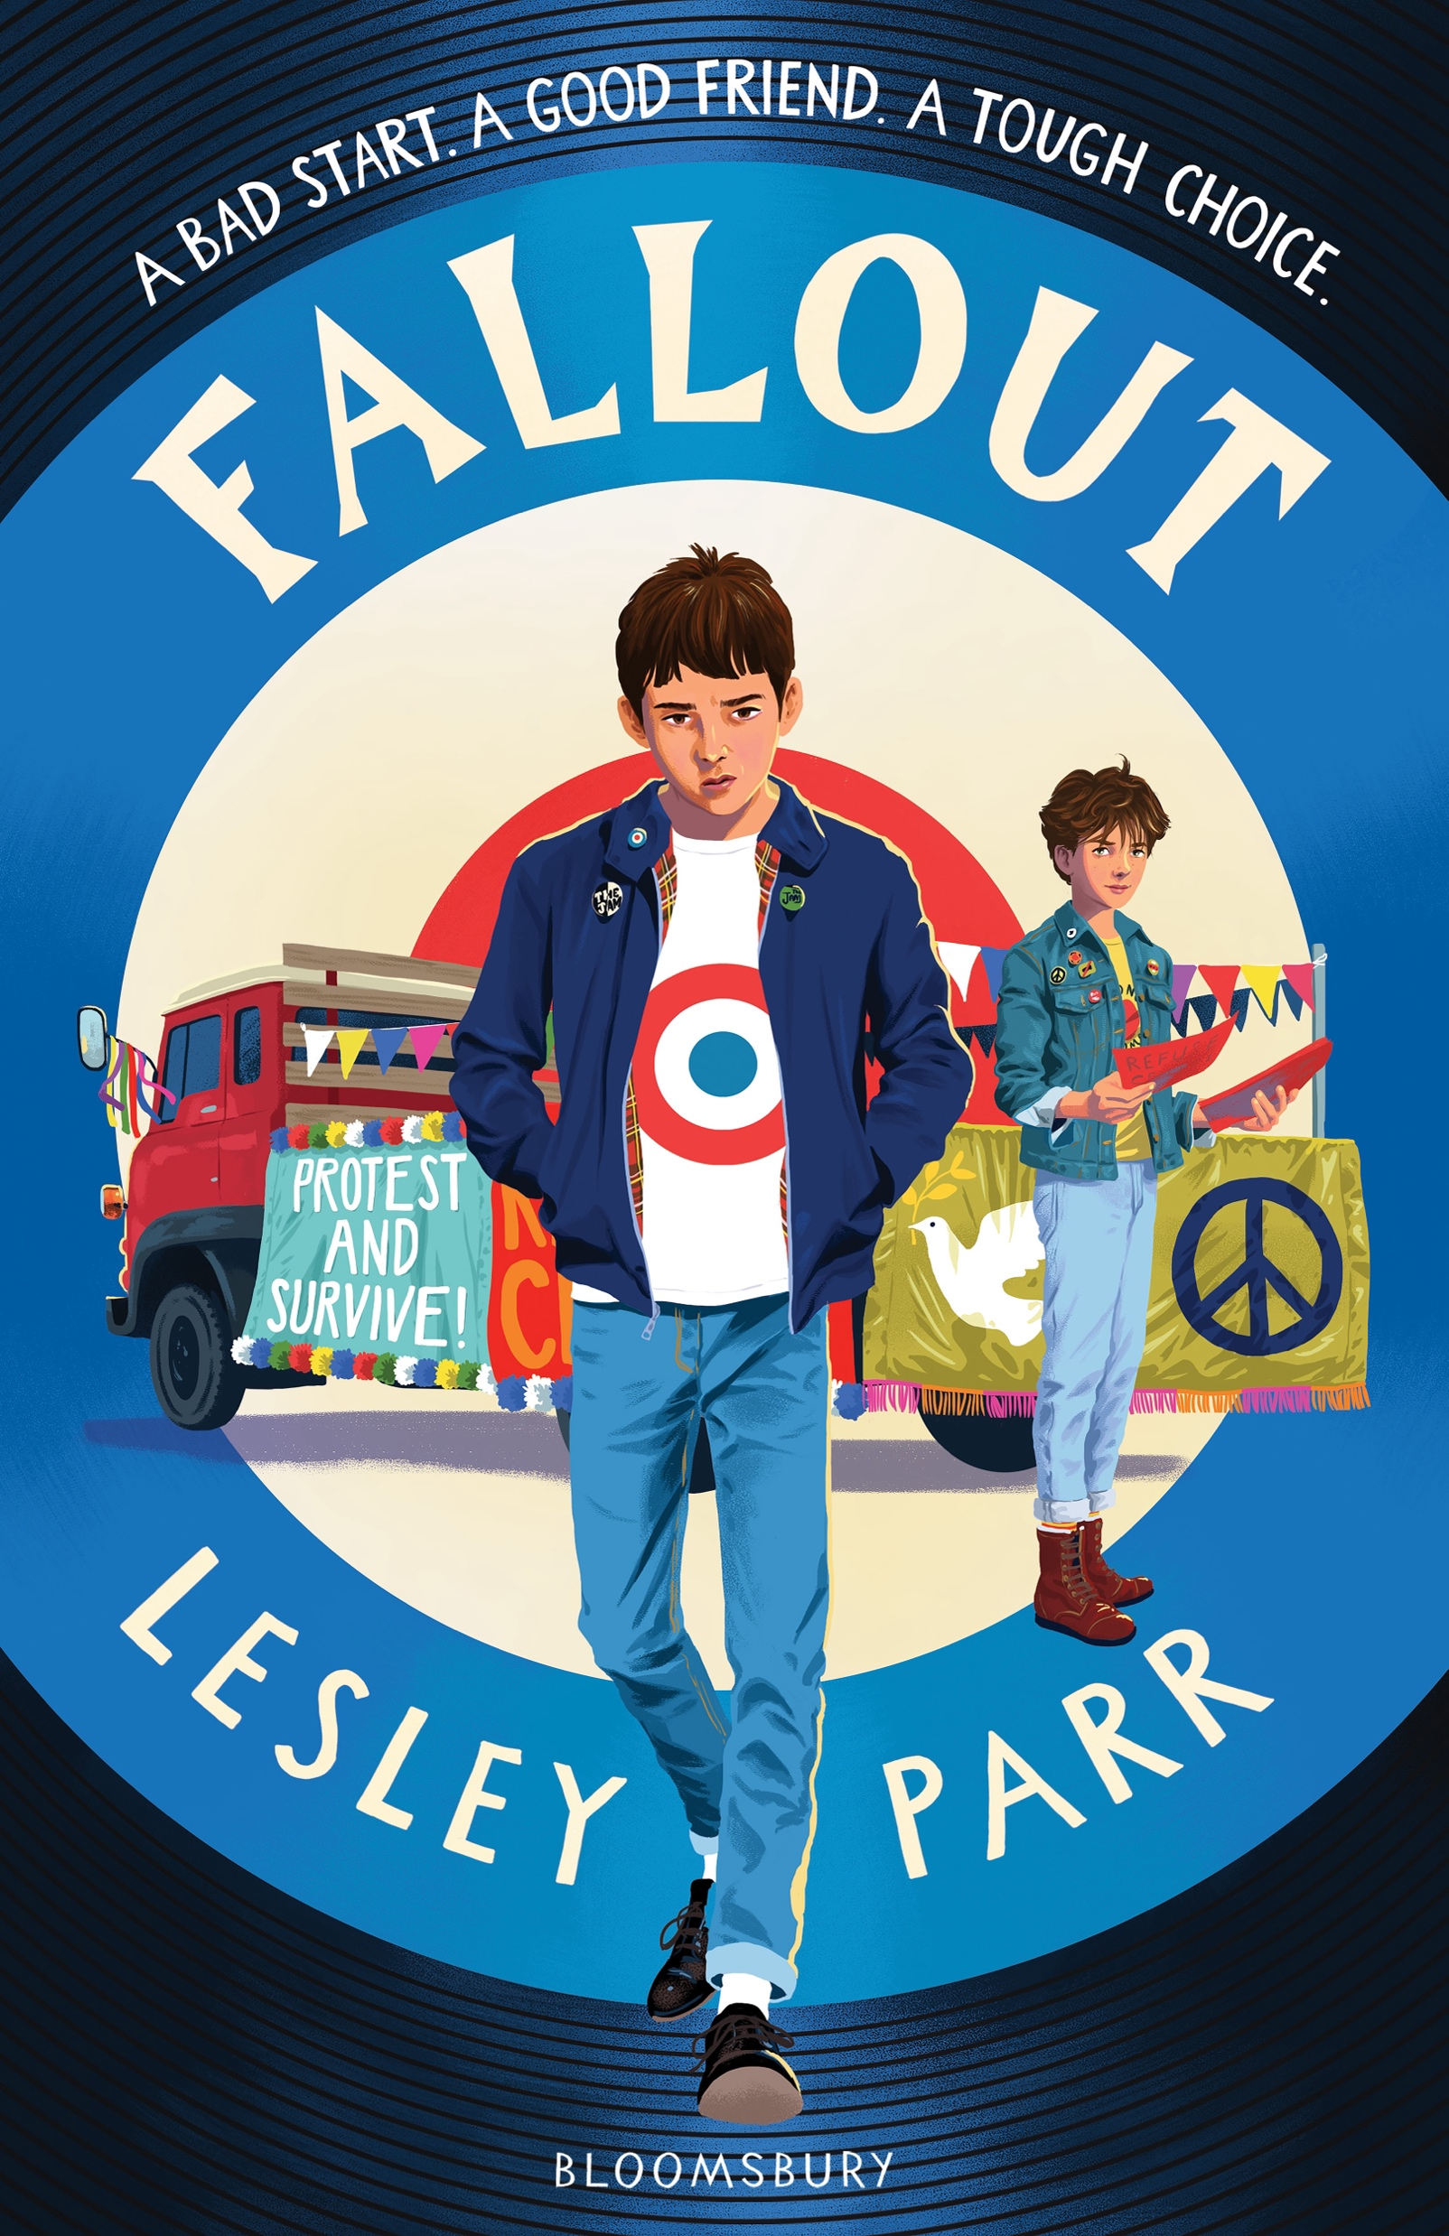
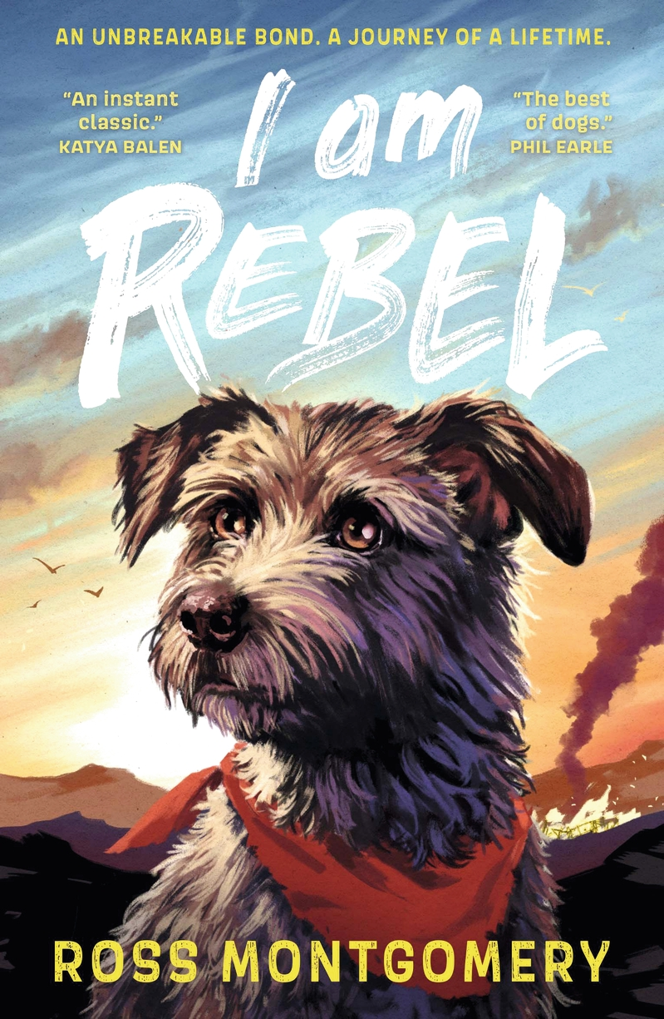
This year’s books

Slide 3
Toxic
By Mitch Johnson
Genre: adventure, thriller
Key themes: conservation, friendship, survival
A fast-paced adventure survival story full of twists and turns.
Jessica’s pretty annoyed about being dragged along on another of her parents’ scientific research trips. Latest destination: the Amazon rainforest. But when she stumbles onto an incredible secret about a rare frog, she and her new friend Renata find themselves caught between the dangers of the rainforest and a ruthless billionaire who will do anything to get their hands on the frog.
Pages: 288

Slide 4
Lunar
By Chris Bradford, illustrated by Charlotte Grange
Genre: adventure, science fiction
Key themes: space, science, survival
A dyslexia friendly race-against-time novella blending science fiction and science fact.
Luna lives on the moon with her dad, whose job is to look for valuable minerals that can be used on Earth. But when a meteorite storm hits the moon base, Luna gets separated from the other astronauts during the evacuation and is left behind. Stranded and alone, with limited oxygen, she must use all her know-how and ingenuity to survive until rescue comes.
Pages: 72

Slide 5
The Girl Who Couldn’t Lie
By Radhika Sanghani
Genre: real-life drama, funny
Key themes: friendships, growing up, school
A relatable and funny coming-of-age story about school, family and friendships.
Worried about disappointing people, Priya always says everything’s fine, even when it isn’t – and lately things haven’t been fine at all. Then something odd happens: her grandmother’s special bangle gets stuck on her wrist, and suddenly Priya cannot lie. Compelled to spill secrets and tell brutal truths, it’s a total disaster! Can Priya figure how out to say what matters before everything spins out of control?
Pages: 304

Slide 6

The Boy to Beat the Gods
By Ashley Thorpe
Genre: action, thriller
Key themes: power, fighting, community
An action-packed, page-turning adventure about ancient gods, power and rebellion.
The Orisha are seven ruthless, destructive gods who rule the lands where Kayode lives. When they kidnap Kayode’s little sister, he’s determined to get her back. Taking a huge risk, he eats one of the forbidden fruit from the Orisha’s sacred baobab tree, which gives him the gods’ powers. Will his new powers be enough to destroy the Orisha and save his sister?
Pages: 272

Slide 7
The Double Life of Ted Amos
By Simon James Green, illustrated by Jennifer Jamieson
Genre: funny, real-life drama
Key themes: friendship, bullying, school
An inclusive, contemporary comedy about surviving school.
Despite dreams of popularity, after an unfortunate incident last year Eddie is most definitely at the bottom end of the social ladder. So when his parents separate and his dad moves to another town, Eddie hatches a brilliant plan. He can be someone completely different at his dad’s place: someone cool. Juggling two versions of himself will be easy – right?
Pages: 336

Slide 8
The Edge of the Silver Sea
By Alex Mullarky
Genre: adventure, magic
Key themes: environment, myths and fairytales, family
A contemporary story brimming with magic.
Blair is furious when her parents move their family to a remote Scottish island. Desperate to get home to her friends, she makes a dangerous bargain with one of the island’s dark fey folk, Cailleach: complete Cailleach’s three tasks and she will grant Blair’s wish. But completing them is far from easy and could have terrible consequences – yet if she doesn’t, Blair will be bound to Cailleach forever…
Pages: 280

Slide 9
Safiyyah’s War
By Hiba Noor Khan
Genre: historical, real-life drama
Key themes: war, bravery, grief
An incredible World War II tale inspired by true events.
When war arrives in Paris, everything changes for Safiyyah: her once safe and colourful city now feels dangerous and scary. The mosque compound where her father works and her family lives is her refuge, but Safiyyah soon discovers it’s also a secret refuge for others too. As her family become deeply involved in the resistance, helping persecuted people to safety, how long can they escape the Nazi’s notice?
Pages: 336

Slide 10

The Book of Useless Knowledge
By Neon Squid
Genre: nonfiction, facts
Key themes: science, history, geography
A super-fun, highly illustrated fact book packed with details you never knew you needed to know!
Did you know that Australia moves 8cm every year? That it’s possible to walk on custard? Do you know about the lizard that can shoot blood from its eyes? Or that you can’t fold paper more than seven times? With subjects including geography, space, science, history and nature, it’s full of surprising and inspiring facts.
Pages: 160

Slide 11
Impossible Creatures
By Katherine Rundell, illustrated by Tomislav Tomić
Genre: fantasy, quest
Key themes: bravery, mythology, magic
Join Mal and Christopher’s quest in this immersive fantasy adventure.
The Archipelago is home to all the world’s mythical creatures, from dragons to krakens to centaurs, and the source of all magic. It’s Mal’s home too. But the Archipelago is in danger: the magic is failing. Plus, someone just tried to murder Mal and she has no idea why. To find answers and try to save the islands, Mal and her new ally Christopher embark on a incredible, life-changing journey across the Archipelgo.
Pages: 384

Slide 12

Stitch Head The Graphic Novel
By Guy Bass, illustrated by Pete Williamson
Genre: graphic novel, fantasy
Key themes: belonging, friendship, empathy
A fun, atmospheric and accessible gothic style graphic novel.
Professor Erasmus spends his days in creepy Castle Grotteskew building and bringing to life his monstrous Frankenstein-like creations. He’s forgotten all about the first one he made, Stitch Head, who now lives a lonely life hoping the professor will one day remember him. But when Fulbert Freakfinder comes looking for monster for his travelling circus, everything is turned upside-down. To protect his home, can Stitch Head find the courage to step out from the shadows?
Pages: 144

Slide 13
Hercules: The Diary of a
(Sort Of) Hero
By Tom Vaughan, illustrated by David O’Connell
Genre: funny, diary
Key themes: school, friendship, family
A laugh-out-loud comedy, told through Hercules’ hilarious diary entries.
Hercules is an ordinary boy with big dreams of being cool. But when he starts a new school, things quickly go wrong – he gets in trouble with the headmaster and is targeted by the school bully. However, when his birth dad, Zooey, arrives, everything changes. Zooey has a knack for getting whatever he wants and agrees to grant Hercules three wishes. Will Hercules use his wishes wisely – or unwisely?
Pages: 280

Slide 14
The Nine Night Mystery
By Sharna Jackson
Genre: mystery, crime
Key themes: friendship, secrets, family
An intricately plotted mystery where everyone has something to hide.
When Wesley discovers the dead body of his neighbour, Rachel, he suspects foul play. He and his mum threw Rachel a surprise birthday party the night before, so now the entire guest list are suspects – even Wesley’s mum. Wesley and his friends are determined to solve Rachel’s murder, but their investigation soon reveals everyone has been keeping surprising secrets – including Rachel…
Pages: 496

Slide 15
Reek
By Alastair Chisholm, illustrated by George Caltsoudas
Genre: thriller, dystopia
Key themes: bravery, friendship, equality
A dyslexia-friendly, gripping sci-fi conspiracy thriller set in a futuristic world.
Everything changed after the disgusting ‘reek’ poisoned the air. Now, everyone must buy air from the all-powerful Zephyr Industries just to survive. There are lots of Zephyr rules to follow and if you don’t – no air. Sparrow does her best to get by, but when she’s blamed for an explosion she becomes Zephyr’s target. In a race against time, can Sparrow clear her name before her oxygen runs out?
Pages: 152

Slide 16
Shadowhall Academy: The Whispering Walls
By Phil Hickes
Genre: horror, mystery
Key themes: ghosts, friendship, school
A spine-tingling ghost story with a mystery to solve.
Making new friends turns out to be the least of Lillian’s worries when she starts at her new boarding school, Shadowhall Academy. The school is old and chilly, with rumours of strange sightings and vanished students. Are they just whisperings or are there dark secrets in the school’s past? Then Lillian and her roommates begin to experience strange things themselves. Can they uncover the truth before someone else dies?
Pages: 224

Slide 17

Fallout
By Lesley Parr
Genre: real-life drama
Key themes: crime, protest, friendship
A gritty and gripping drama story about real-life concerns.
Everyone knows you can’t trust a Pritchard. One of Marcus’s brothers is locked up; the other is working with their dad on plans for the next big robbery. Everyone expects Marcus to be trouble too, but what if he doesn’t want to follow in his family’s footsteps? With everyone assuming he’s bad news, how can Marcus prove them wrong – and is it even worth trying?
Pages: 336

Slide 18
I Am Rebel
By Ross Montgomery
Genre: adventure, quest
Key themes: animals, war, courage
An incredible adventure story of determination, bravery and survival.
Rebel is a loving dog who adores life on the farm with his boy Tom. For Rebel, every day is perfect – but Tom feels differently. When Tom runs away to join the people’s army and fight against a brutal dictatorship, Rebel is devastated. Determined to find and protect Tom, Rebel undertakes an epic journey across mountains, through towns, city and wilderness, facing many dangers and challenges along the way.
Pages: 304

Slide 19
Which will you choose?

