Slide 1


Spread the Story Competition
Who would you like to share a story with — and why?
Think about a story that matters to you.
Who would you choose to share it with?
How would you share it?

Slide 2
The Prizes!
First Prize (x1):
• £3k of inclusive books provided in consultation with the BookTrust books team and inclusive books expert, Sanchita Basu De Sarkar
• An in-person school visit by an author of colour, organized by BookTrust in consultation with your school
• A book to keep of the winner’s choice
• 100 copies of the visiting author’s books so that children can have a signed book to keep after the author visit
Runner up Prize (x2)
• A book to keep, chosen by each winner
• 100 inclusive books for each winner’s school
Highly Commended Prize (x10):
• A book to keep, chosen by each winner
All winning entries will be published on the BookTrust website

Slide 3
Learning Objectives
Choose a story you would like to share
Explain who you would like to share it with and why
Think about different ways stories can be shared
Plan an entry using words, pictures, or both
Key words:
connection
choice
audience
Notes:
Teacher note: This competition is about personal choice. There are no right or wrong answers — pupils should be encouraged to choose a story, person, and method that feel meaningful to them.

Slide 4

When we share a story, we are making a connection with others by sharing ideas, feelings, memories and imagination.

Slide 5
Why do we share stories?
We might share a story because we want to:
Make someone laugh
Help someone feel understood
Spend time with someone we care about
Introduce someone to a favourite character
Talk about a big idea
Remember a special moment
Help someone see the world differently
Discussion question:
Think of a time when someone shared a story with you.
How did it make you feel?

Slide 6

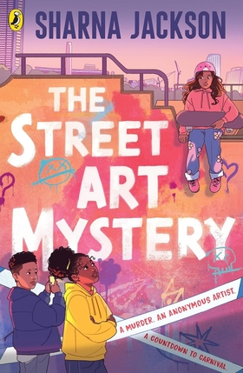




Choosing your story
The story you choose could be:
A picture book
A chapter book
A graphic novel or comic
A poem
A traditional tale
A story from your family or community
A story you have made up yourself
A book you loved when you were younger
A story you think someone else would enjoy

Slide 7


What makes a story worth sharing?
A story might be worth sharing because it is: Brilliantly illustrated A story that made you think or feel differently Full of interesting characters Linked to your life or memories About something important to you

Slide 8



Discussion question:
Think of three stories you know.
What makes each one special?

Slide 9
Complete this sentence:
The book I would like to share is ……… because ………… .
If you know the author and illustrator, you could add their names in too:
The book I would like to share is ……… written by ……… and illustrated by ………… because ………… .

Slide 10
When we choose a story to share, we also need to make a choice about who we want to share the story with.

Slide 11
Who would you like to share a story with?
You could choose: A friend A family member A teacher Someone in your class Someone who lives far away A group of people Someone who you have never met in person
Think about:
Why this person?
Why this story?
Why now?

Slide 12

You might want to share your story with someone because: You think they would enjoy it It reminds you of them You want to cheer them up You want to help them understand something You want to spend time together You both like similar stories You want to introduce them to a new kind of book The story connects to something you have shared together

Slide 13
Complete these sentences:
I would like to share this story with ………… .
I chose this person because …………… .
I think they would enjoy this story because ………… .
Extension:
This story reminds me of them because …………… .

Slide 14
Thinking about the person you are sharing with – the audience - will help you come up with the best ideas about how to share the story.

Slide 15


How would you share the story?
There are lots of ways to share stories. Think about the person you have chosen and what would make the story special for them.

Slide 16
How would you share the story?
You could:
Read it aloud together
Tell the story in your own words
Show the pictures and talk about them
Act out part of the story
Draw a scene and explain it
Make a comic strip version
Record yourself reading it
Send it as a letter, postcard or recommendation
Discussion question:
Which way of sharing would make your chosen person most excited about discovering the story you want to share?

Slide 17
Complete these sentences:
I would share the story by……………
This would be a good way to share it because…………
I hope this story would make them feel…………..

Slide 18
Developing your ideas
Before you write or draw your final entry, think about these questions:
What happens in the story?
What do you like about it?
Why did you choose this story?
Why did you choose this person?
How do you hope they will feel when the story is shared with them?
What would you talk about together afterwards?
What makes your choice personal or meaningful?
You can answer using:
Up to 350 words
Pictures
A mixture of words and pictures
You do not need to write a book review. Focus your entry on your choices and explain them clearly.

Slide 19
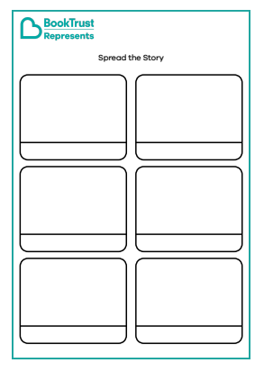



Final checklist
Remember to include:
The story you would like to share
The person you would like to share with
How you would share the story
Why you made these choices
Words, pictures, or both
No more than 350 words, if writing
Notes:
Teacher prompt:
Encourage pupils to focus on the relationship between the story, the person and the method of sharing. The strongest entries will explain not only what they have chosen, but why those choices matter.
Reminder:
The strongest entries do not need to summarise the whole story. They should clearly show why the pupil chose this story, why they chose this person, and why their chosen way of sharing feels thoughtful or special.

Slide 20
Read on to find out how some of our favourite authors would Spread the Story…

Slide 21
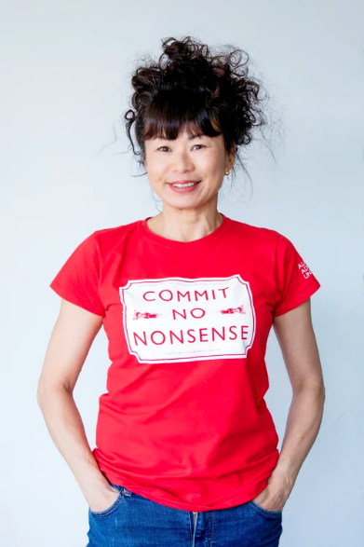

Spread the Story x Lui Sit
The book I would like to share is Boss of the Underworld: Shirley vs The Green Menace by Tor Freeman.
The person I would like to share it with is my friend Caroline who is scared of cockroaches like me. There is a friendly cockroach called George in this book and now I see them differently.
The way I would like to share this story is dressing up myself and my friends as the characters in the story and communicating it through interpretive dance.
Lui is the author of Land of the Last Wildcat, The Wildcat and the Gathering Storm, and The Lucky House Detective Agency

Slide 22
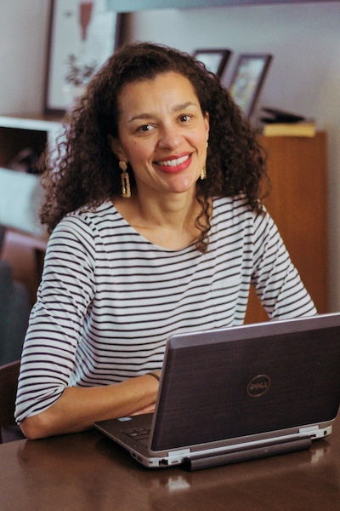

Spread the Story x Luan Goldie
The book I would like to share is Press Start to Play by Sam Gayton. It's a poetry book, but the poems are all based on games and set within the world of gamers.
The person I would like to share it with is anyone who thinks poetry is dry! Okay, some poetry is very dry, but Sam Gayton's poems are clever, funny and often interactive.
The way I would like to share this story is by starting off with the disclaimer that I'm not a gamer. Aside from the odd game of Mario Kart, I have very little to do with games, but I know loads of children are obsessed with gaming. This book is a great way to get gamers reading, writing and 'playing' with poetry.
Luan is the author of Skylar and the K-pop Headteacher and Oops, I Kidnapped a Pharaoh!

Slide 23
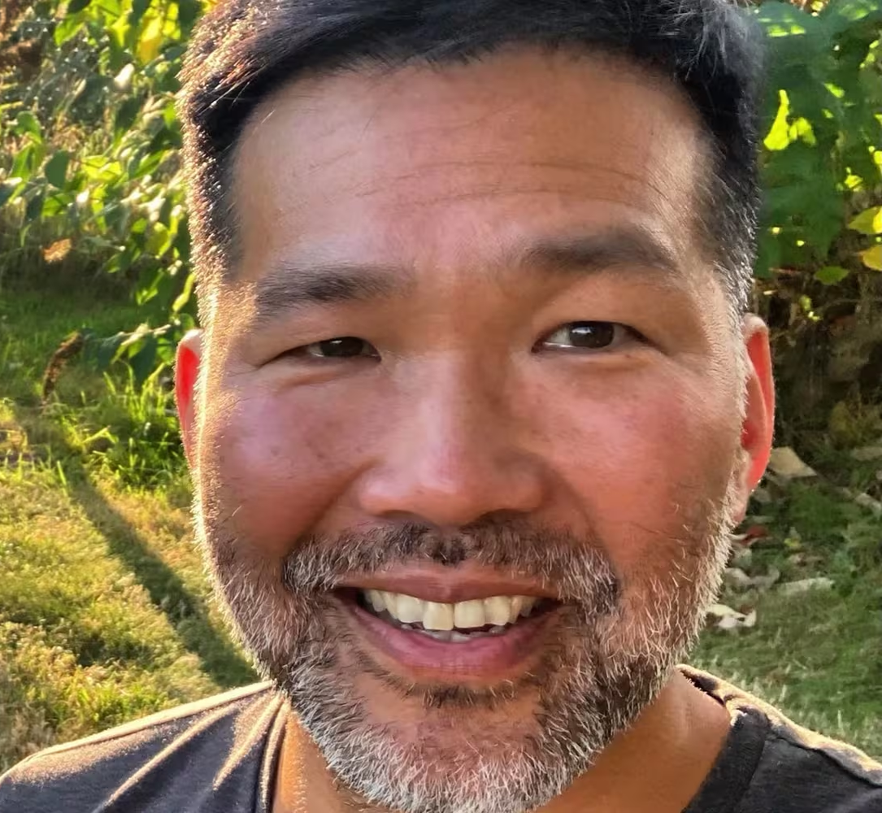

Spread the Story x Eric Huang
The book I would like to share is Nate Yu’s Blast from the Past by Maisie Chan because it’s a spooky mystery that’s laugh-out-loud funny.
The person I would like to share it with is my neighbour’s son, Paul who loves all of these elements, including the Nintendo Switch, which Nate also loves.
The way I would like to share this story is to spend an hour being Nate, which would involve playing on the Switch, observing ants, and researching Chinese dragons.
Eric is the author of the Guardians of the New Moon series.

Slide 24
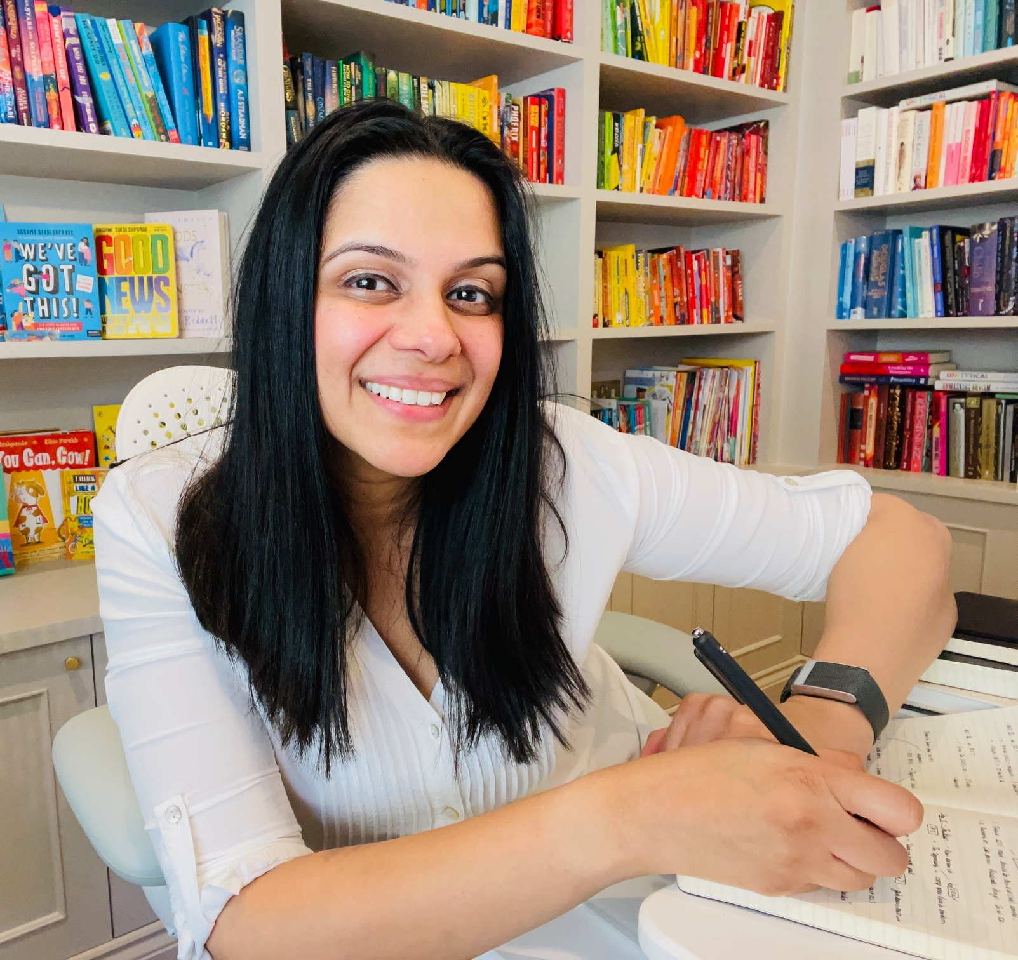

Spread the Story x Rashmi Sirdeshpande
The book I would like to share is A Dinosaur Ate My Sister by Pooja Puri and Allen Fatimaharan because it's fast-paced, funny and wildly inventive!
The person I would like to share it with is my friend who loves funny books, illustrated books AND time travel stories (a triple hit). AND if they love it, there are two more books in the series.
The way I would like to share this story is by designing and decorating a time machine with all the funky little buttons, levers and labels (because surely EVERYONE needs to do this at least ONCE in their life, right?)
Rashmi is the author of picture books, poetry, fiction and factual books including the Hari Kumar series, Amazing Asia, Super Uma, This Is Who I Am, and Never Show a T-Rex a Book.

Slide 25
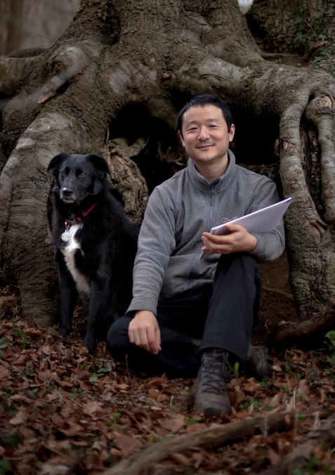

Spread the Story x Kengo Kurimoto
The book I would like to share is Cathedral by David MacAulay. It's about the building of a great cathedral during the Middle Ages and has spectacular drawings of its construction.
The person I would like to share it with is my nephew Blaze. He loves architecture and his favourite building is the Burj Khalifa in Dubai; the tallest building in the world.
The way I would like to share this story is to climb 275 steps to the top of the tower at Yorkminster Cathedral, gazing down at the enormous ancient building. From there, we would open the book, and see how they built it, so long ago with such simple tools and only muscle power.
Kengo is the author-illustrator of the graphic novel, Wildful.

Slide 26
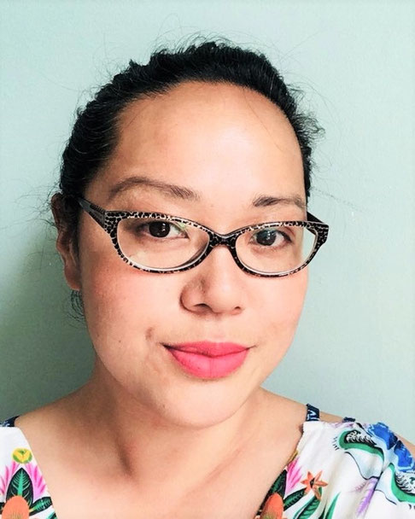

Spread the Story x Maisie Chan
The book I would like to share is The Guardians of the New Moon by Eric Huang because it is a book that has adventure AND you also learn about Chinese mythology at the same time.
The person I would like to share it with is my niece Jia-Mei because she loves animals (she has a dog and a cat) and the book is full of brilliant animals who speak!
The way I would like to share this story is I would dress up as one of the characters from the book (maybe Miaow the cat!) we could think about a 13th Zodiac animal together and draw it. Then we could create a comic about that animal and its superpowers.
Maisie is the author of Chi Chi the Panda, Nate Yu’s Blast from the Past, Keep Dancing, Lizzie Chu, Danny Chung Does Not Do Maths, and the Tiger Warrior series.

Slide 27
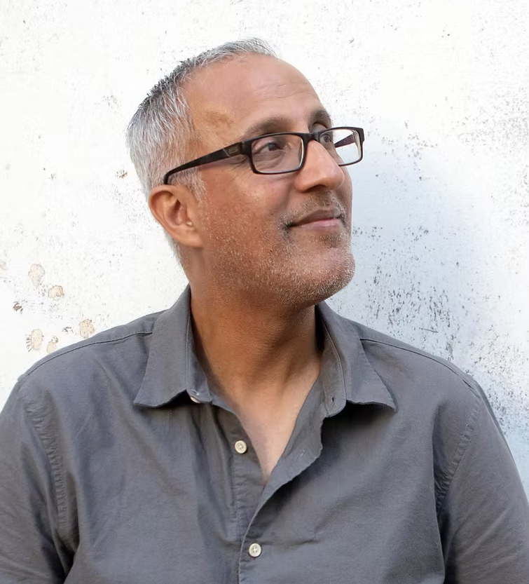

Spread the Story x Iqbal Hussain
The book I would like to share is Harriet the Spy, by Louise Fitzhugh, because it’s funny, clever and Harriet is the person who made me want to become a writer. She carries a notebook and makes notes on everyone and everything. She isn’t always kind, but she’s always true to herself. She made a big impression on me as a kid
The person I would like to share it with is all of you who don’t fit in, who feel different, or who sometimes wonder where you belong.
The way I would like to share this story is I’d give you a spy route to follow, just as Harriet does in the book. Along the way, you’d collect clues in your own notebook, and if you worked out the final destination, you’d discover the book waiting for you!
Iqbal is the author of The Night I Borrowed Time and The Day I Stole the Future.

Slide 28
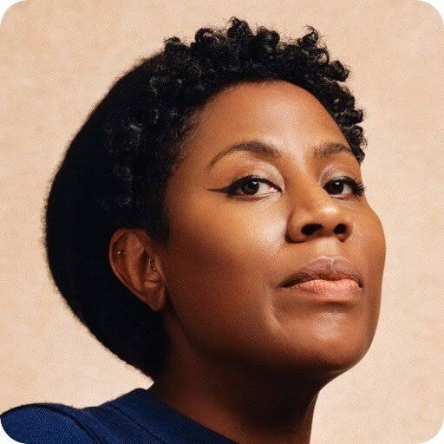

Spread the Story x Sharna Jackson
The book I would love to share is The Runaways by Ruth Thomas. That was my favourite book when I was growing up. It's an adventure story where two regular kids, Nathan and Julia, find a lot of money in an abandoned house. After trying to buy friends with sweets, they fear that the police are going to catch up with them, so they become...Runaways.
I'd share the Runaways with anyone who's curious, is up for going on a little adventure, who wants to discover stories in the streets around them.
We'd share this story in lots of ways – we could look at maps of places we'd love to go to or go on a walk or bike ride. Maybe we could even share it on the ship I live on and go sailing as we read it.
Sharna is the author of books including The Street Art Mystery, The Nine Night Mystery, The Good Turn, Mic Drop, High Rise Mystery, and Black Artists Shaping the World.

Slide 29
Important Dates
Competition opens: 7th September 2026
Deadline for entries: Midnight on Friday 23rd October 2026
Winners announced: January 2027

Slide 30
How to enter:
By email: send entries to Booktrust.Represents@booktrust.org.uk including ‘Spread the Story Competition’ in the email subject line
By post: send entries to Spread the Story Competition, BookTrust, 29 Clerkenwell Road, Farringdon, London, EC1M 5RN
Please include the name and age of each entrant but ensure no names/ages are visible on the entries themselves.
Note: Entries are restricted to a maximum of five entries per year group for each school.

