Slide 1


The book that represents me…
Winning Entries

Slide 2
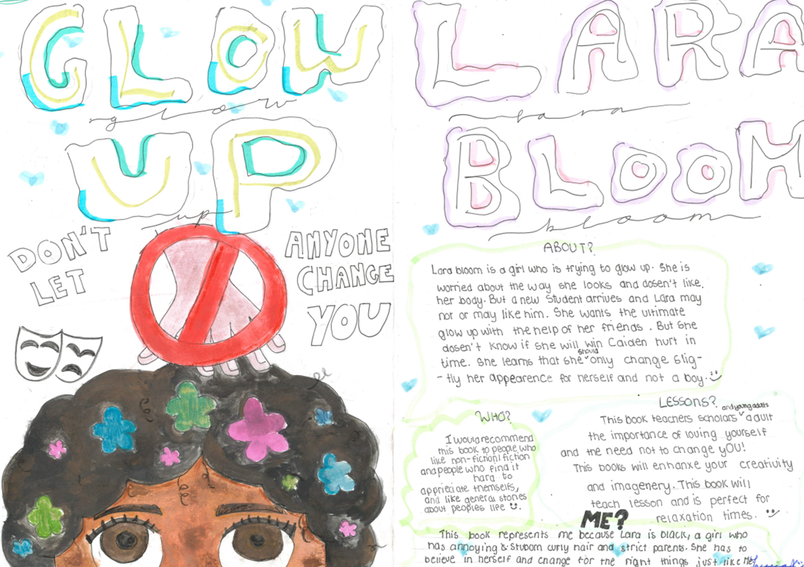
1st Prize
JESSICA, 13
BROOK MEAD ACADEMY Leicester

Slide 3
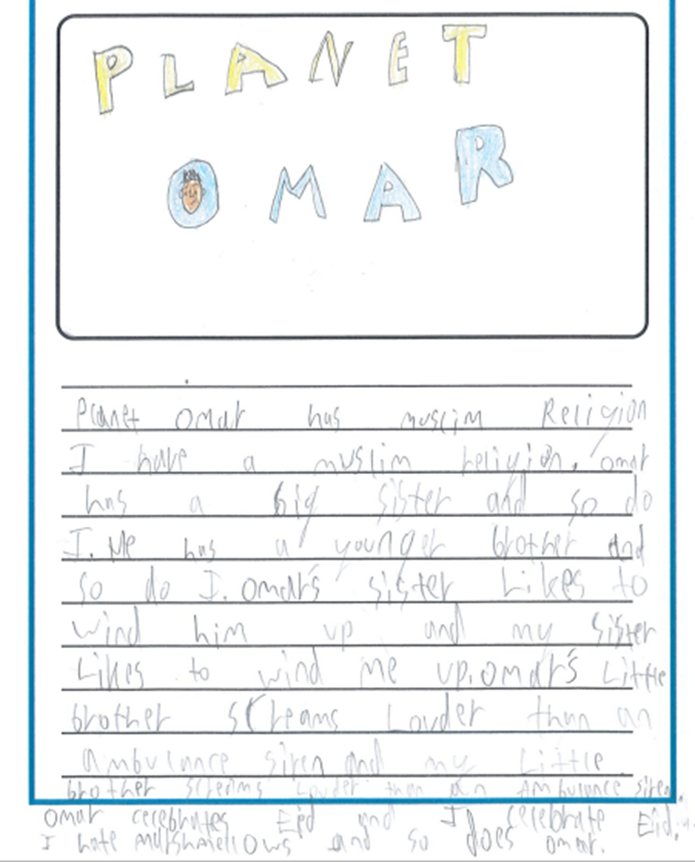
2nd Prize
ALI, 9
NISHKAM PRIMARY SCHOOL Wolverhampton

Slide 4
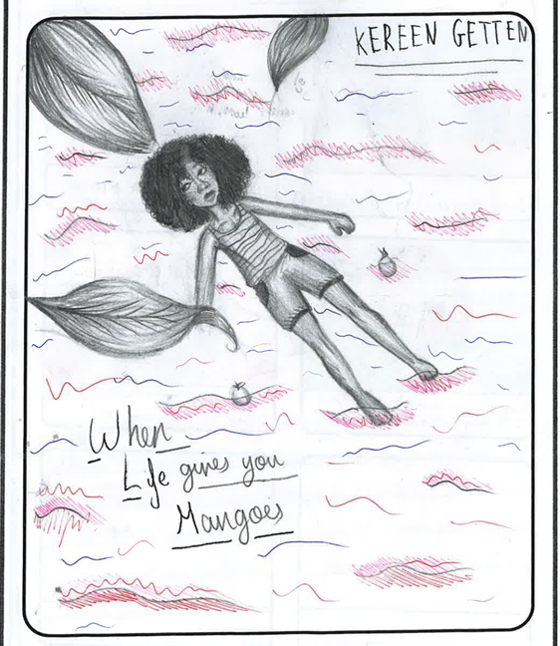
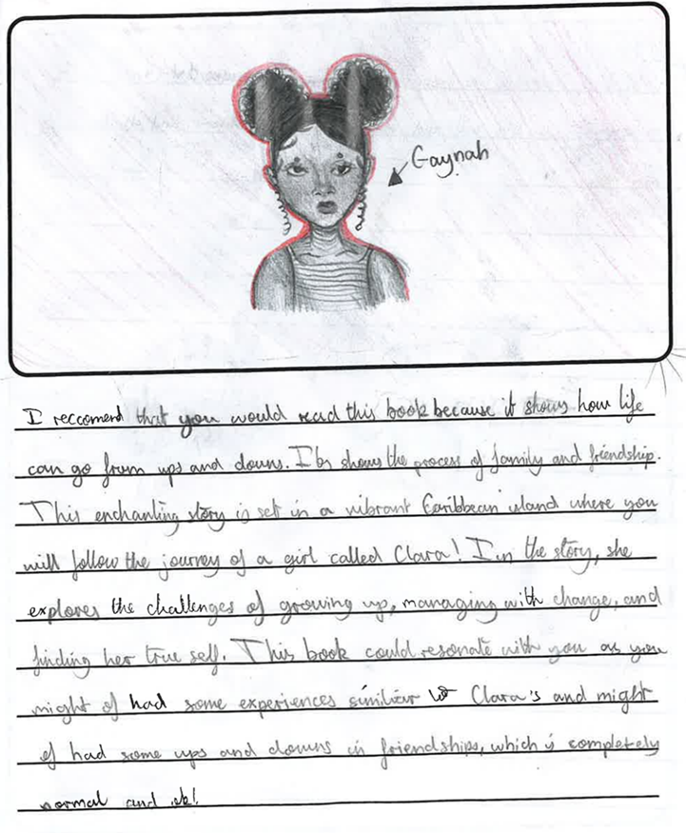
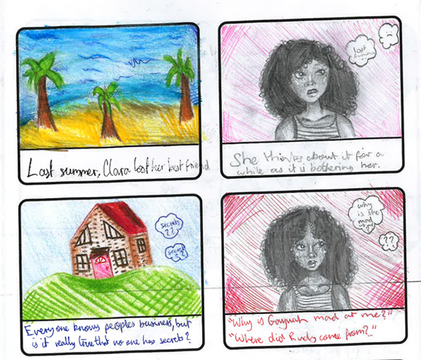
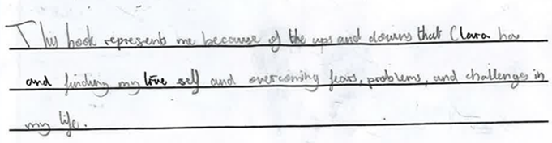
2nd Prize
BINTA, 11
LANE END PRIMARY Leeds

Slide 5
Highly Commended Prizes

Slide 6
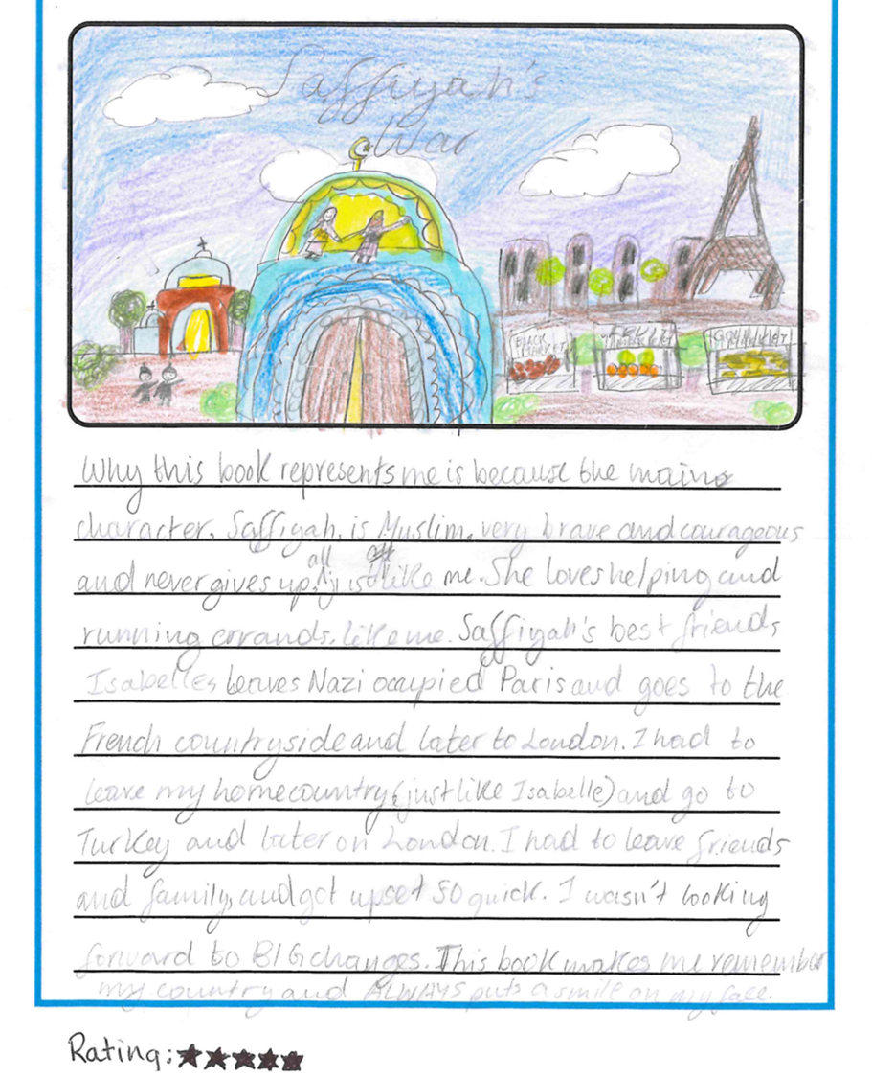
Highly Commended 1st Prize
ARIANA, Year 6
ARK ATWOOD PRIMARY ACADEMY London

Slide 7
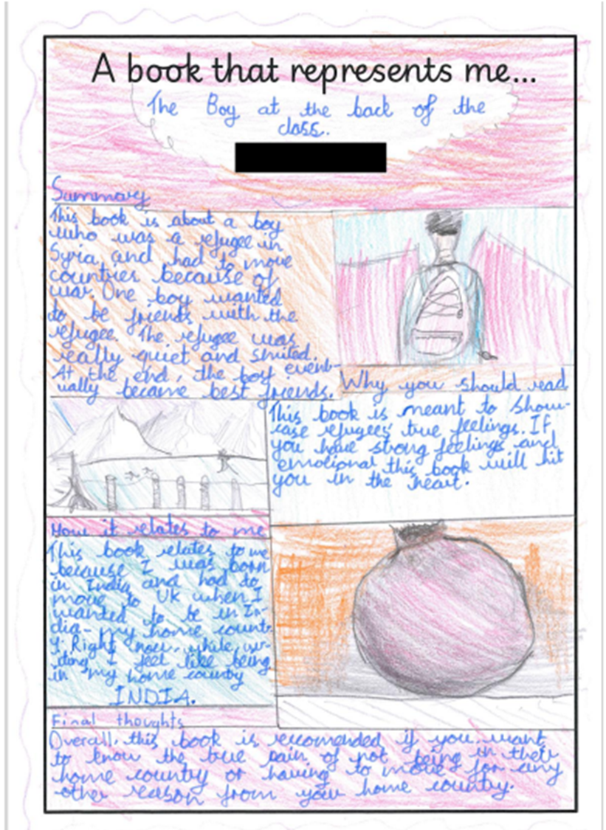
Highly Commended 2nd Prize
AARAV, Year 5
HALLAM FIELDS JUNIOR SCHOOL
Ilkeston, Derbyshire

Slide 8
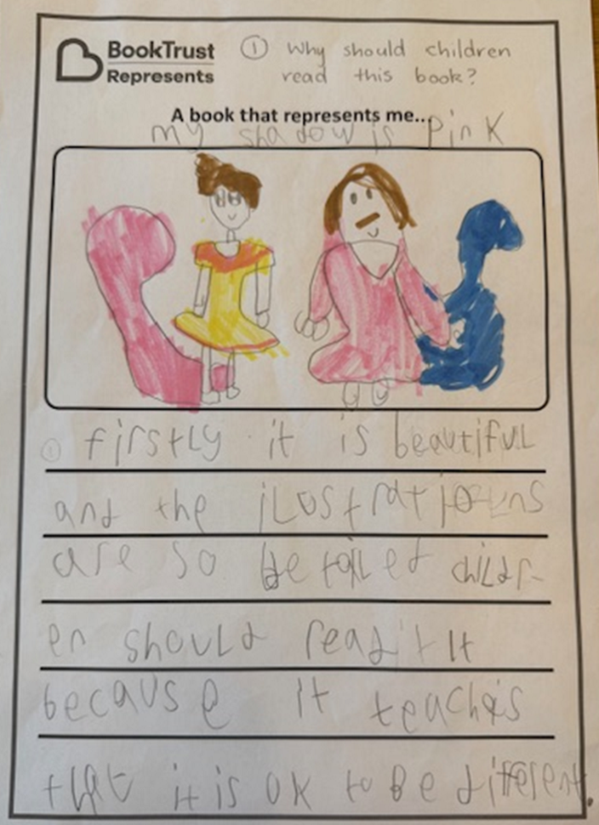
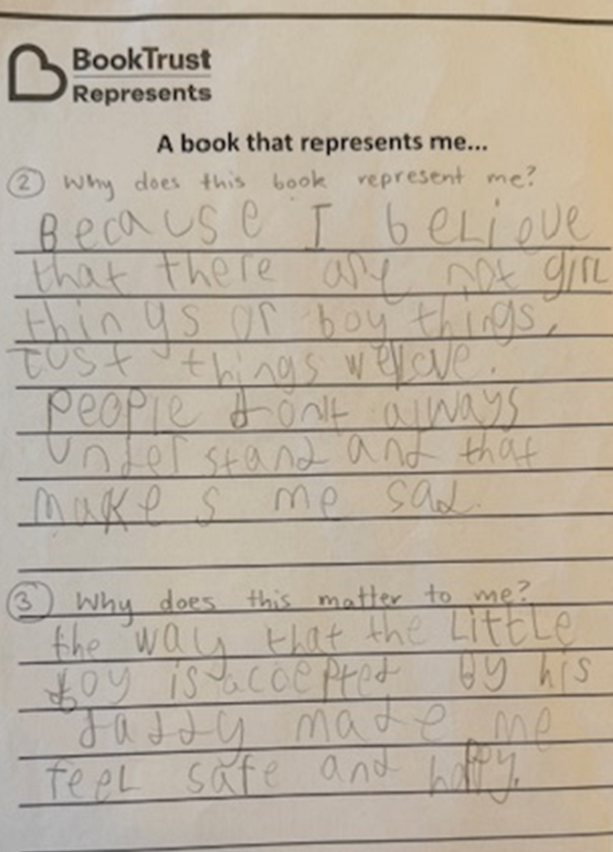
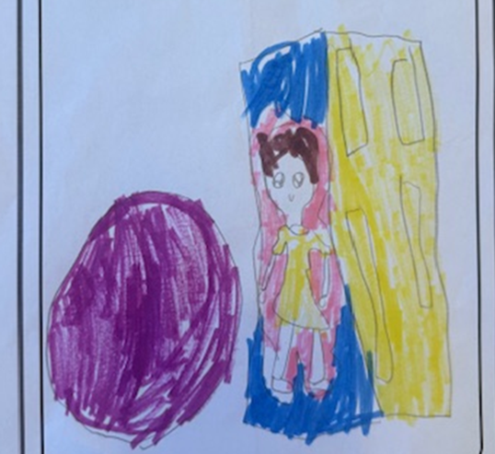
Highly Commended 3rd Prize
XAVIER, 8
SNARESBROOK PREPARATORY SCHOOL London

Slide 9

Highly Commended
HANEEFAH, 12
SARAH BONNELL SCHOOL
London

Slide 10
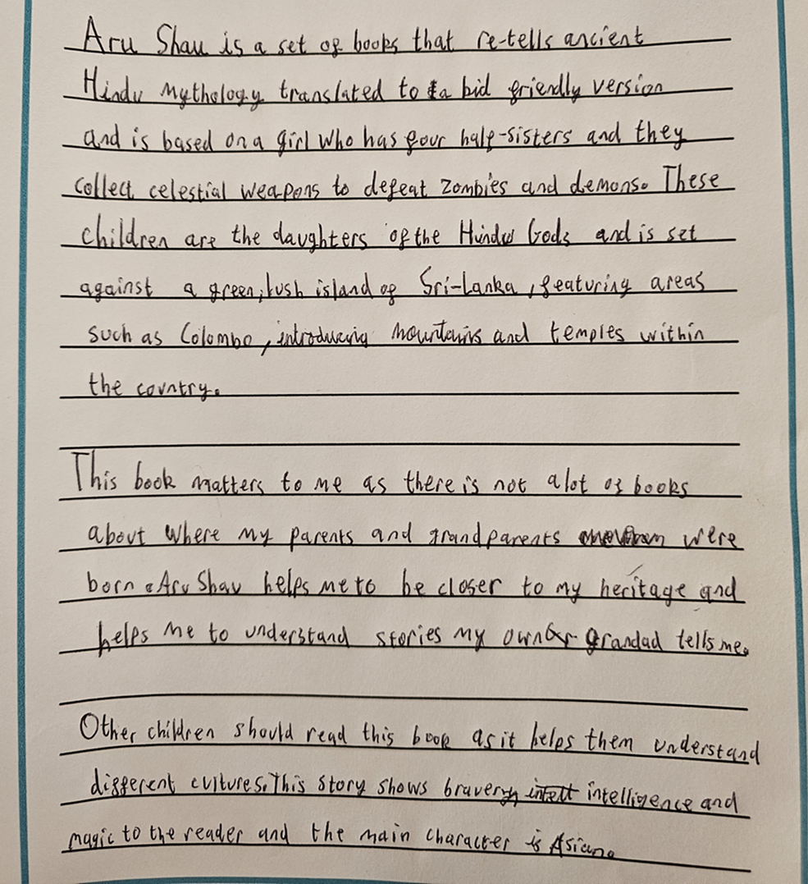
Highly Commended
DHIREN, 9
HARWOOD HILL JUNIOR SCHOOL Welwyn Garden City, Herts

Slide 11
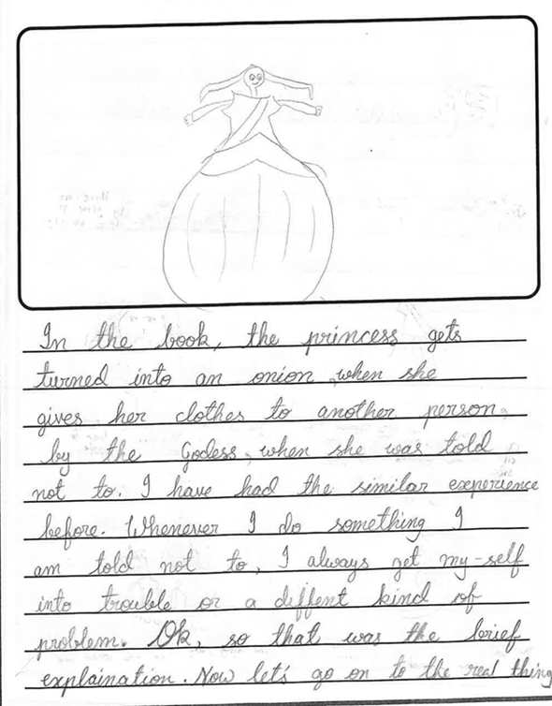
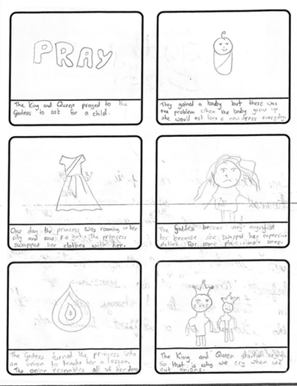
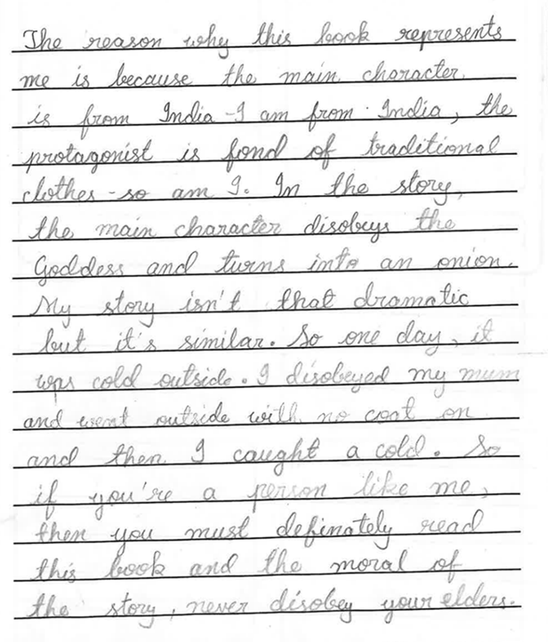
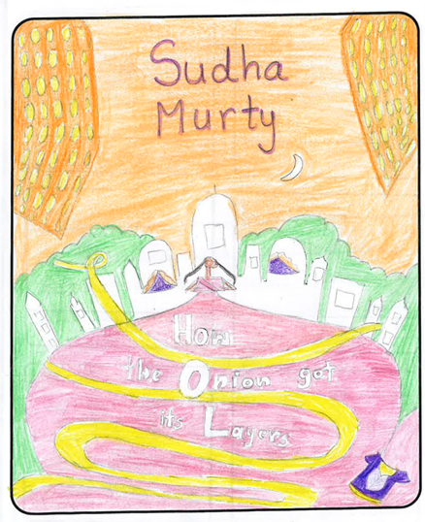
Highly Commended
AADYA, 11
LANE END PRIMARY
Leeds

Slide 12
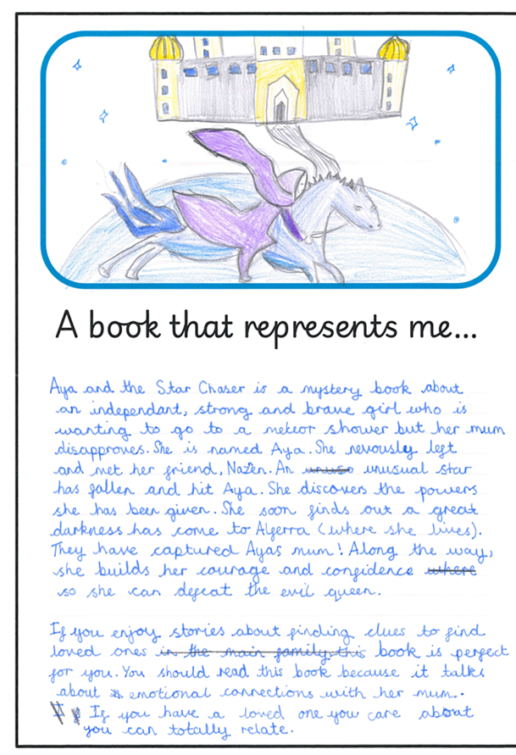
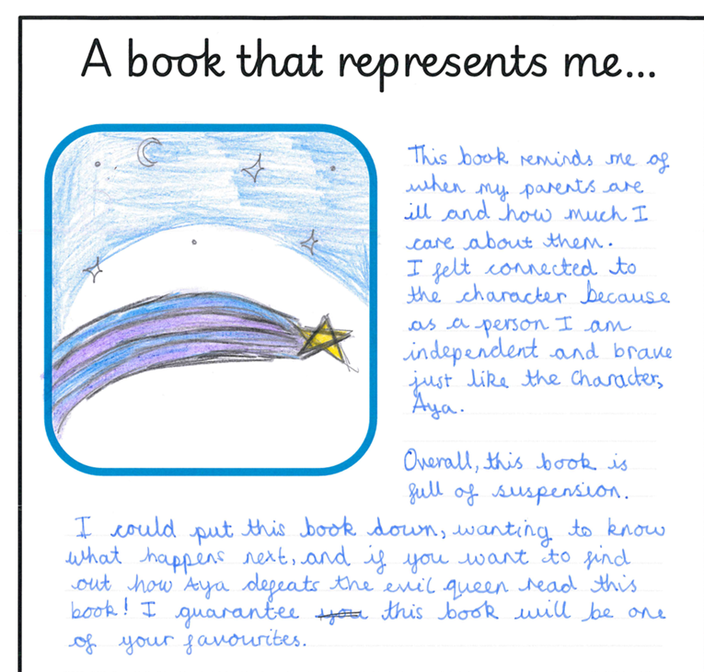
Highly Commended
AKIRA, Year 6
HALLAM FIELDS JUNIOR SCHOOL
Ilkeston, Derbyshire

Slide 13
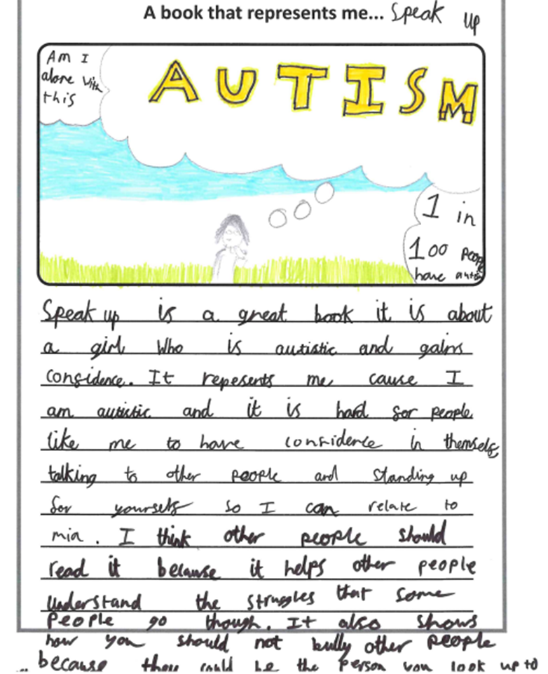
Highly Commended
JESSICA, 12
THE GILBERD SCHOOL
Colchester, Essex

Slide 14
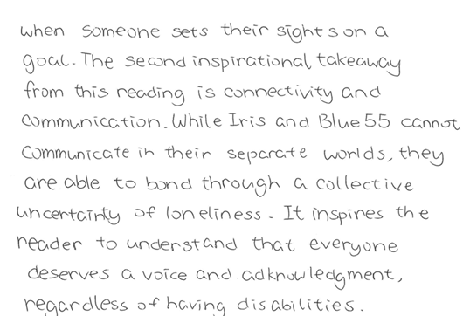
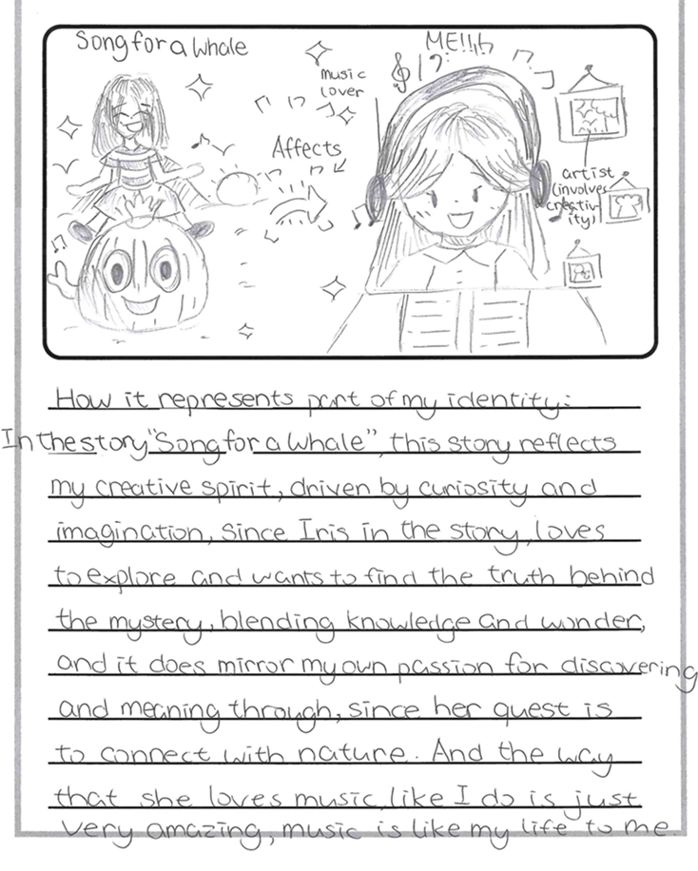
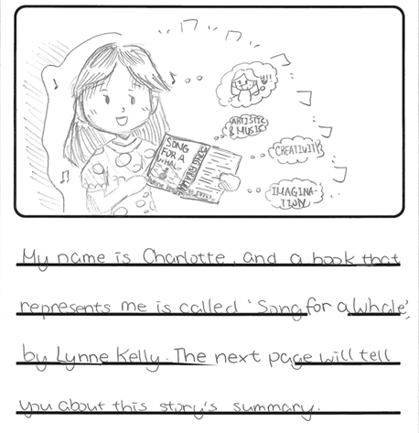
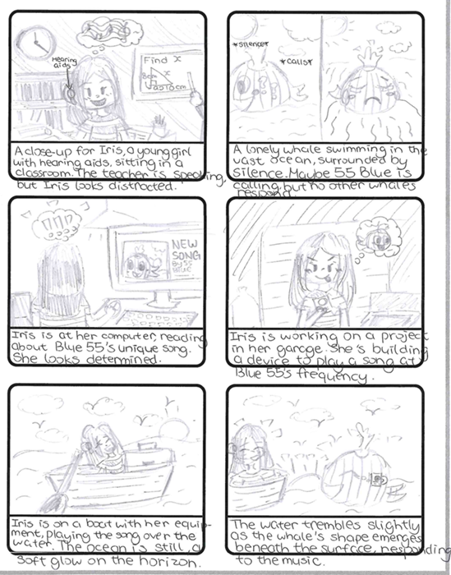
Highly Commended
CHARLOTTE, 11
THE GILBERD SCHOOL
Colchester, Essex

Slide 15
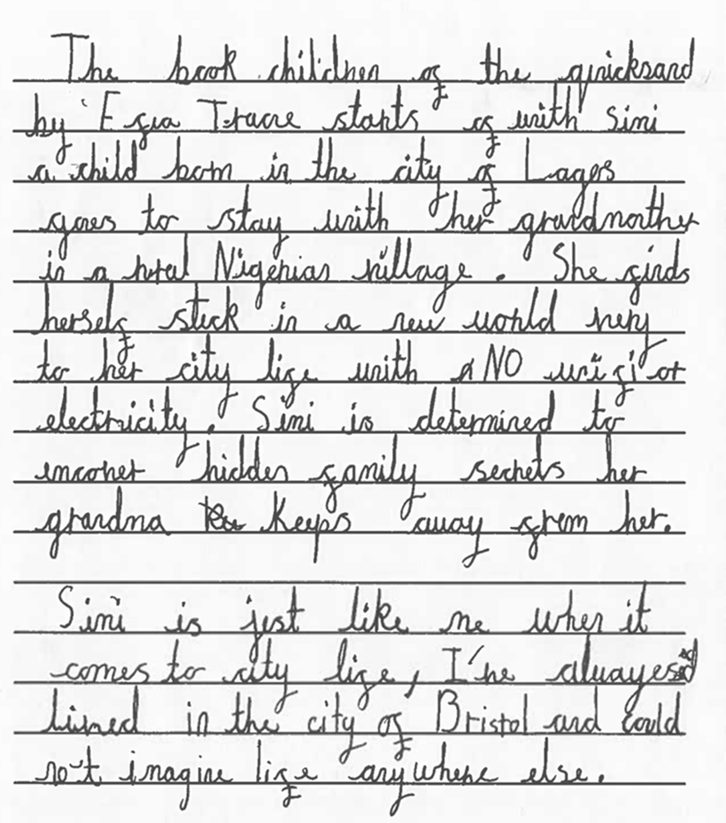
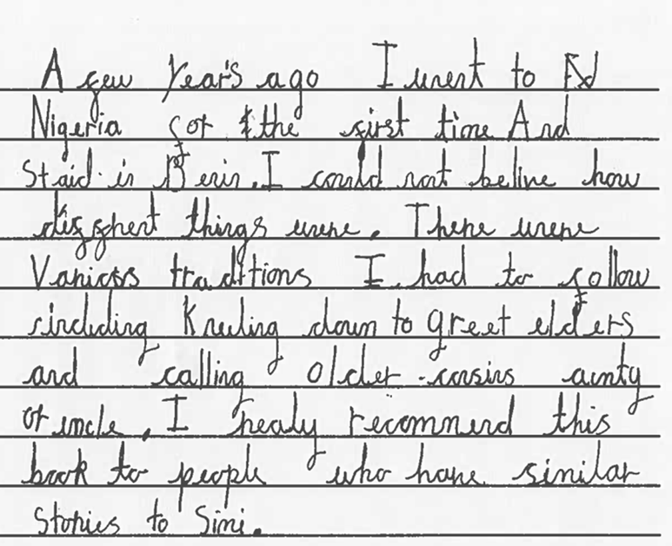
Highly Commended
DIVINO, 10
CABOT PRIMARY SCHOOL
Bristol

Slide 16
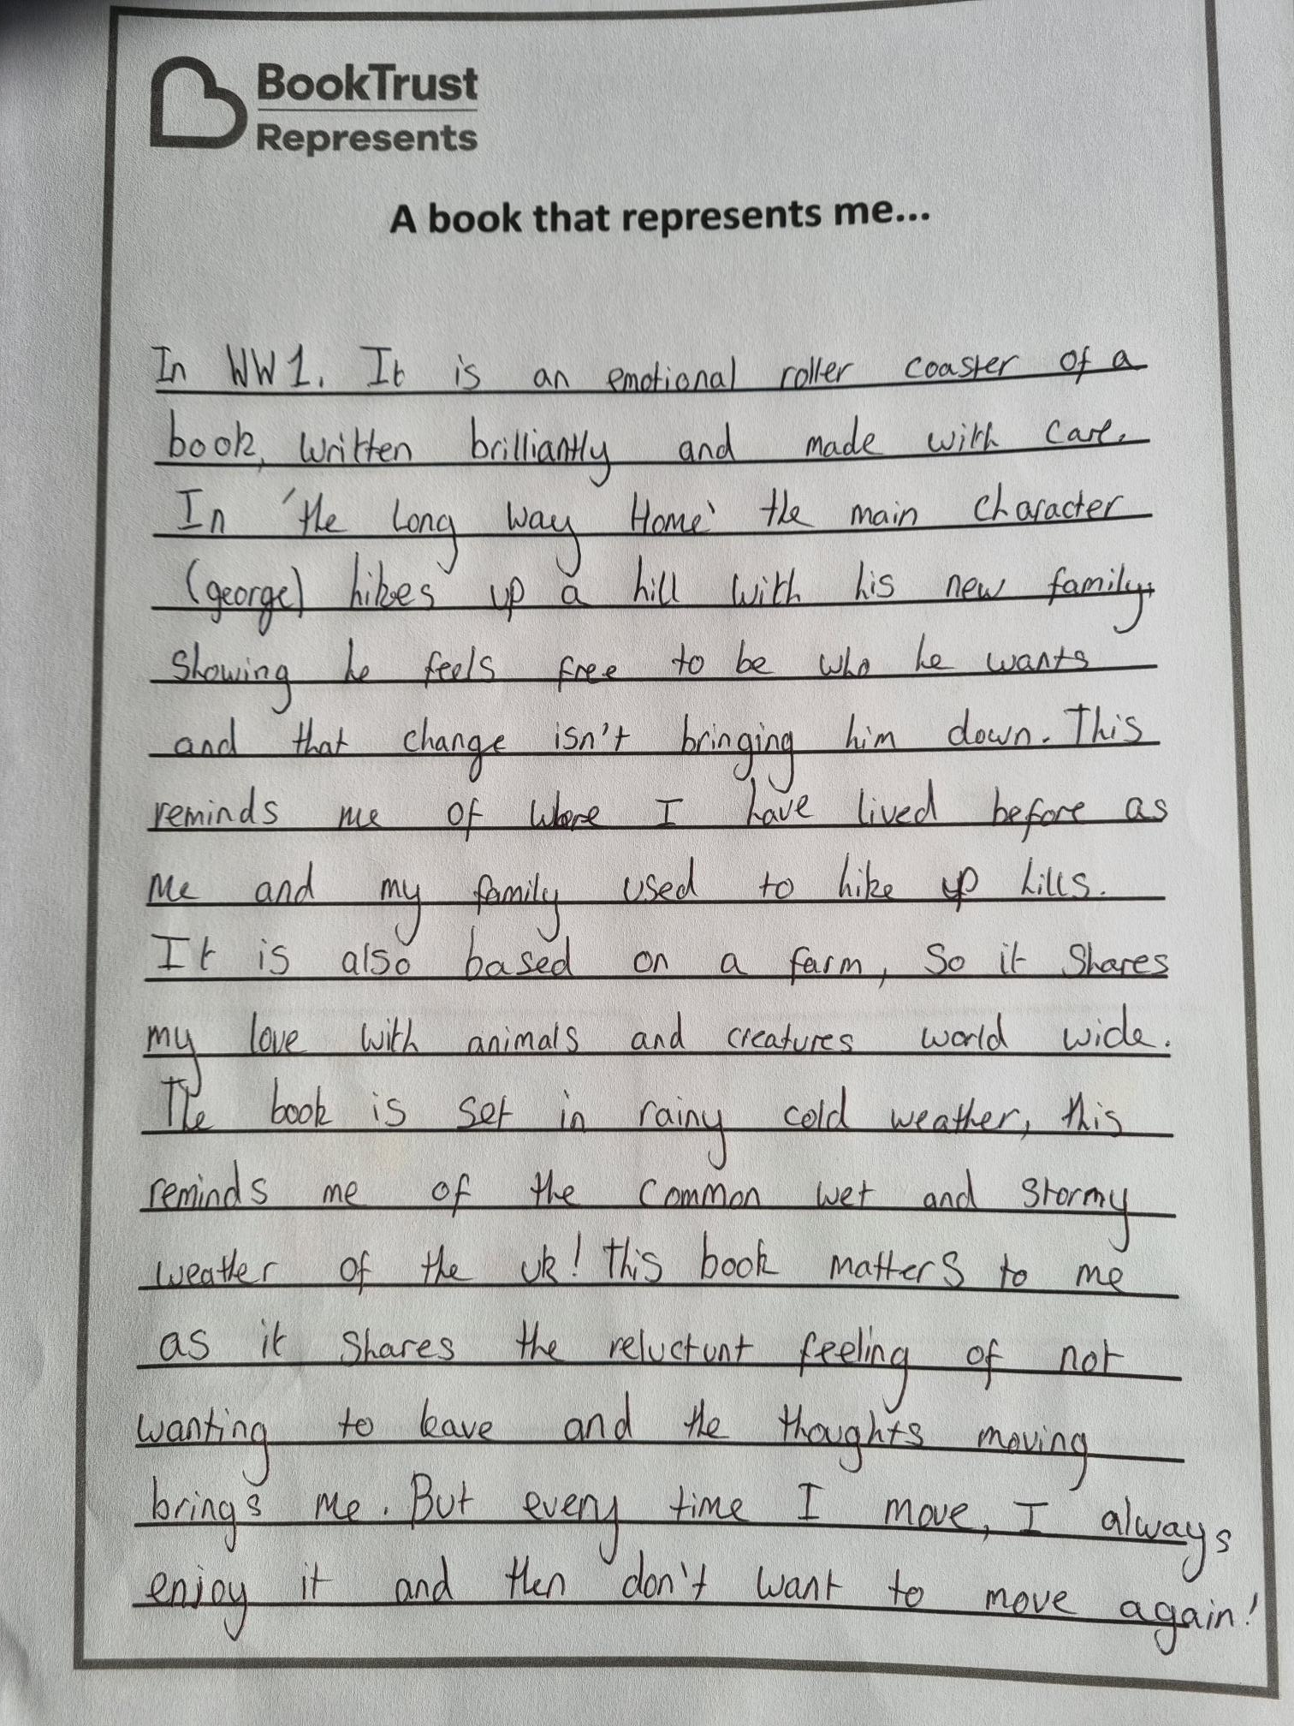
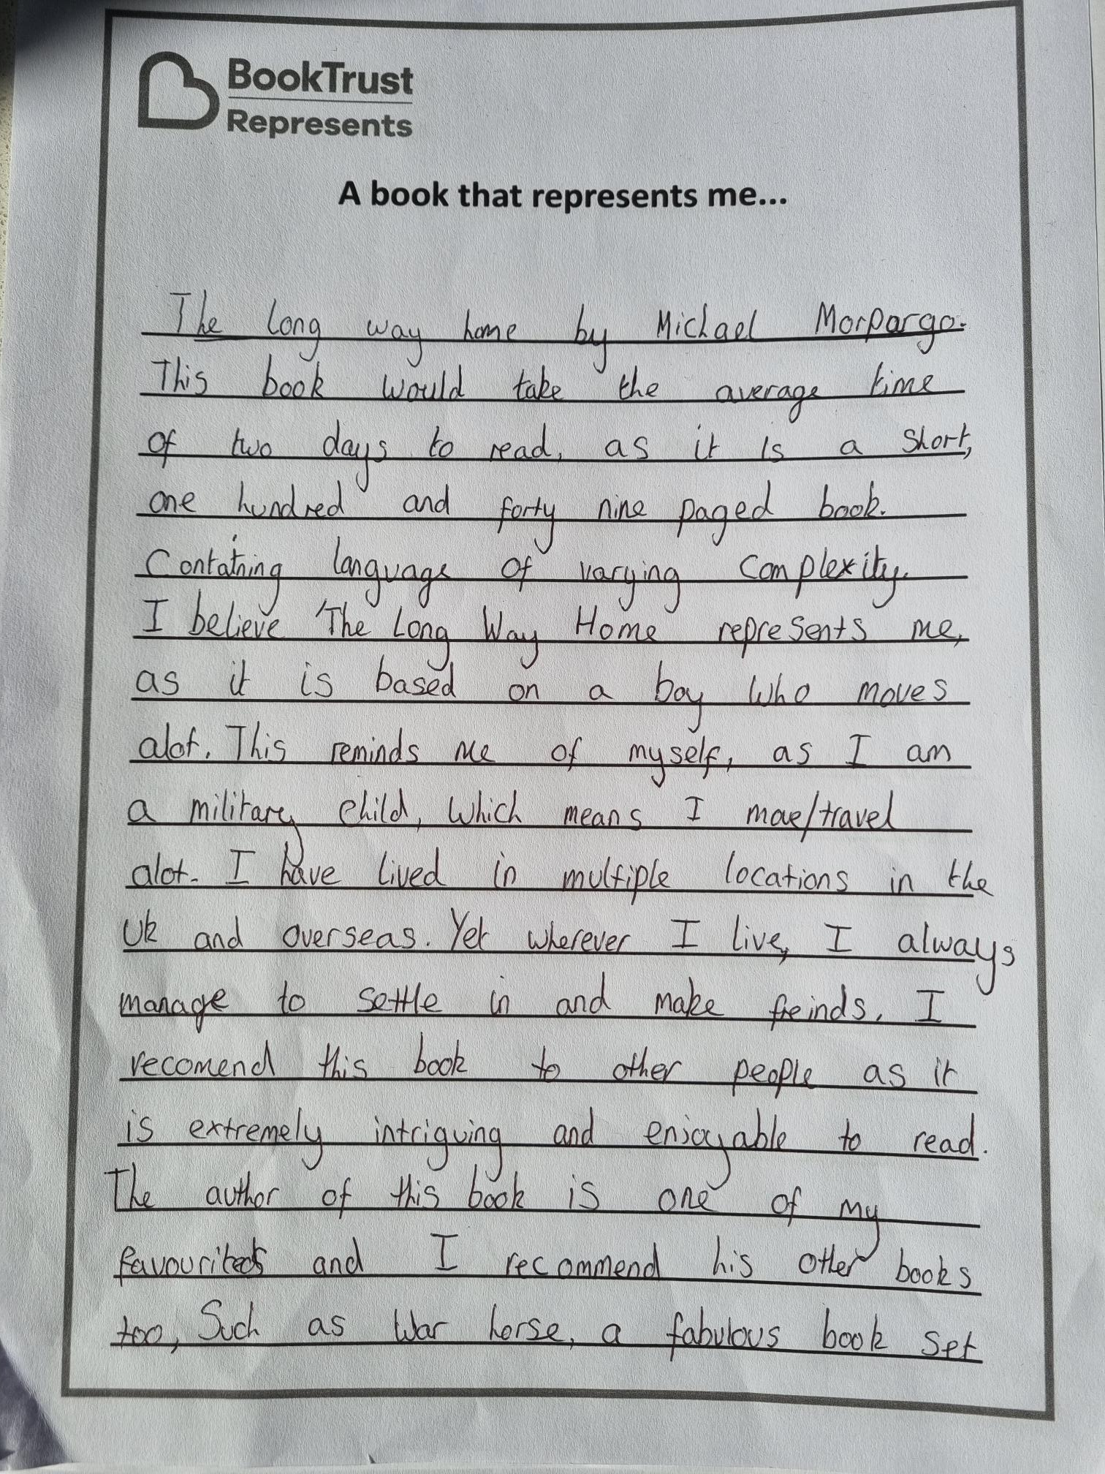
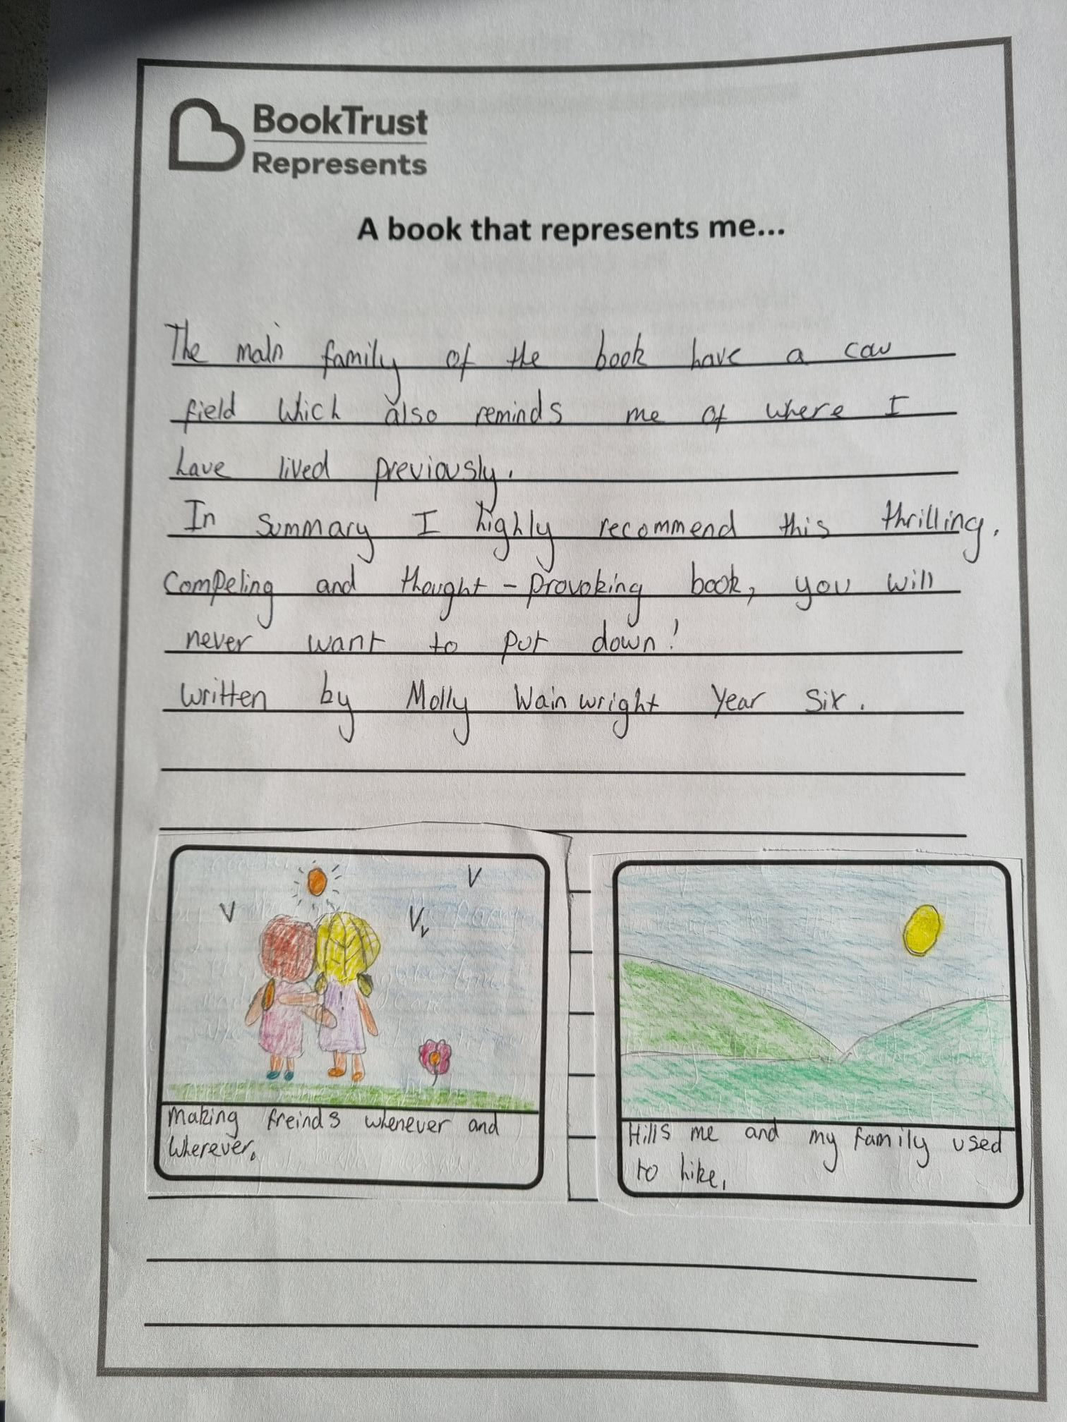
Highly Commended
MOLLY, Year 6
QUEEN BERENGARIA SCHOOL
British Military School, Cyprus

Slide 17
Congratulations to all our winners!
Thank you to everyone who entered and to the librarians, teachers and parents who supported you.

